Slide 1
The Paper Militia The Unofficial Guide to Pre/Post-Apocalyptic Strategies for the African American in Texas and Abroad.
Bean Soup Science Online
www.corenovus.org
9/2020
CommUnity Preppers/Way Of The Radical Series

Slide 2
Bean Soup Science Online
The Non profit leader in nation building networks, programs, products, services and content for the Conscious African American Community.
www.corenovus.org
A new core of thoughts & beliefs for change.

Slide 3
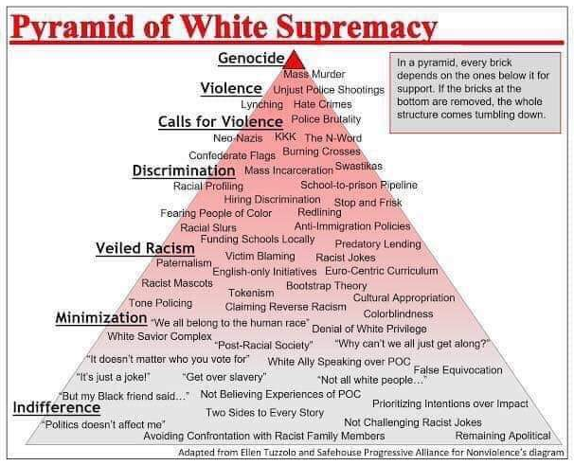
Problem:
The SYSTEM and it’s maintainers.
(The very world we live in… Something is not right).
Universal
Conscious Strategy
(Struggle)
Consciousness (Woke)
Unify (Not uniformed)
Plan (Truth & Transparency)
Organize (Connectivity ability)
Action (Rise & build)
Review results (What works, recycle & repeat)
Grow (We are B.O.R.G.)

Slide 4
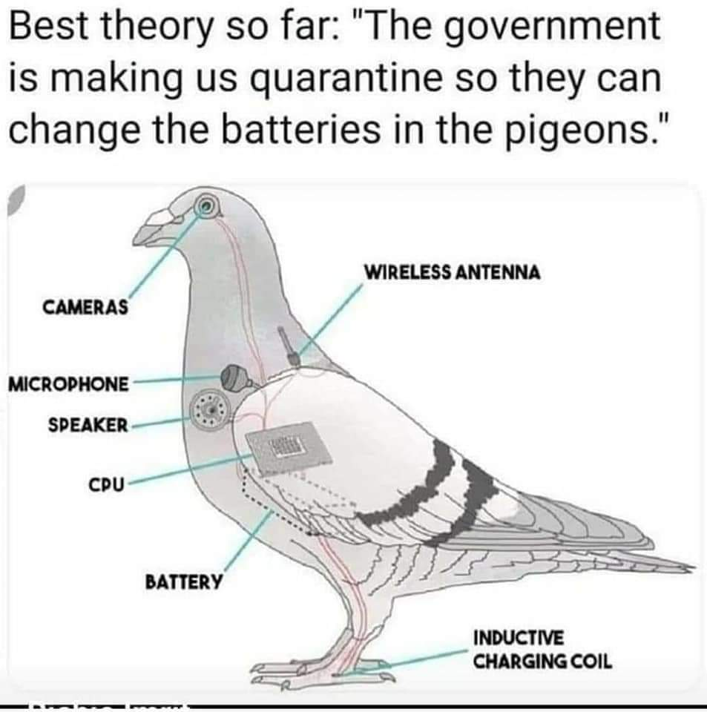
Conspiracy Theory/ Social Media
Consciousness/ Reality
Electoral College
Illuminati
Secret Societies
Selected not elected
Corporations vs. Government
Religions
Nationalism
Gentrification
Electoral College
Illuminati
Secret Societies
Selected not elected
Corporations vs. Government
Religions
Nationalism
Gentrification

Slide 5
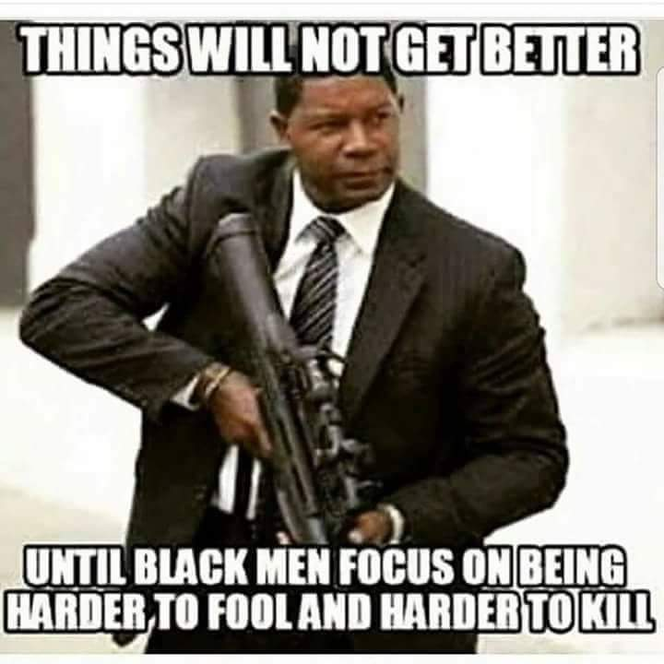
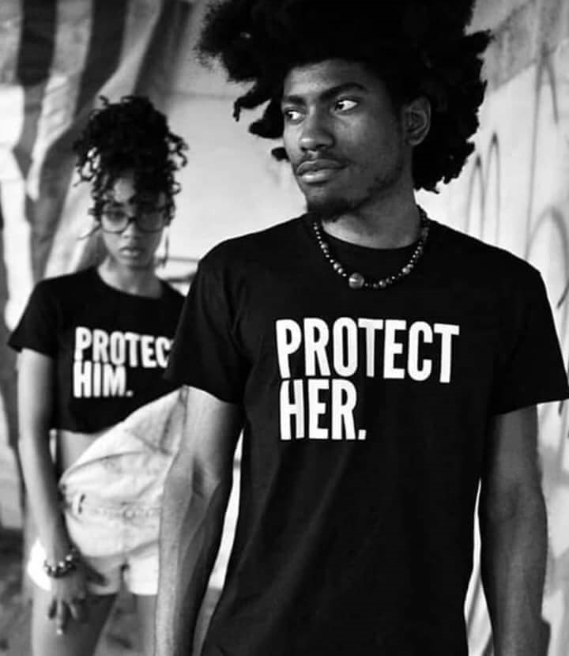
Consciousness Simplified

Slide 6
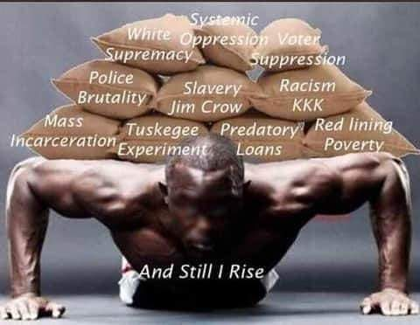
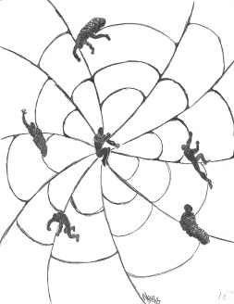
Problems seem overwhelming…
…Good news! There are many solutions!
What is required is building unity!!
4.

Slide 7
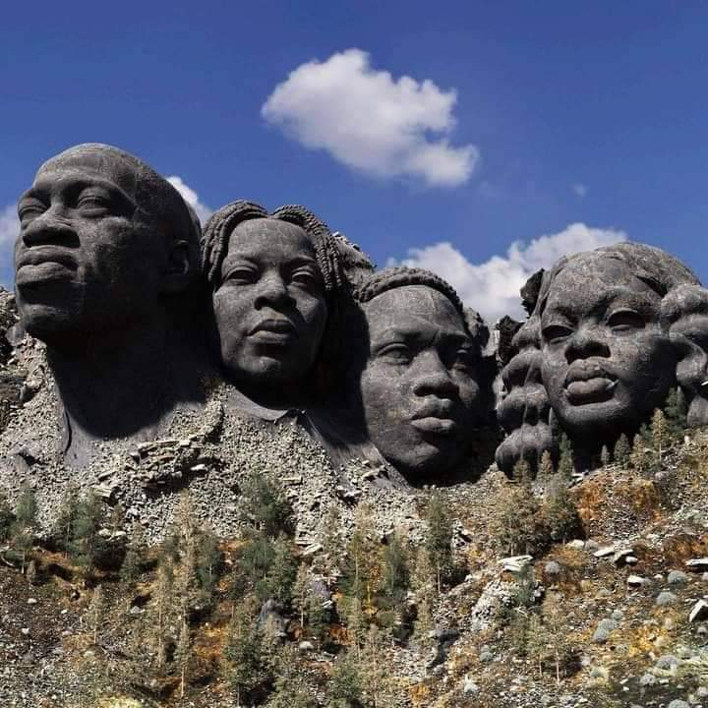
“It is not light we need, but fire…
not the gentle shower, but thunder.
We need the storm, the whirlwind, and the earthquake.”
Frederick Douglass

Slide 8
Monolithic Goals For the Conscious (Woke)
Monolithic Goal #1 – African Americans will create their own scientific/spiritual theology based in Ma’at and proven by manifestations from the God within.
Monolithic Goal #2 –We will create technology, civilization and lifestyles promoting peace, equality, security, and justice.
Monolithic Goal #3 - We will Move our population towards self-reliance from traditional American culture to creating or redeveloping our own.
Monolithic Goal #4 – Create new entertainment concepts that are compatible with our reality and destiny.
Monolithic Goal #5- The consumer/producer relationship will be made amenable to both or a new system will be created.
Monolithic Goal #6- We will take on the status of dual citizenship and create an autonomous nation-state.
Monolithic Goal #7-African Americans will return to a holistic science that is good for the planet and people.
Monolithic Goal #8- African Americans will move to create a Space Industrial Complex.
Monolithic Goal #9- African Americans will continue the American democratic legacy and principles without racism, sexism, and capitalism.
Monolithic Goal #10- African Americans will become space faring people.

Slide 9
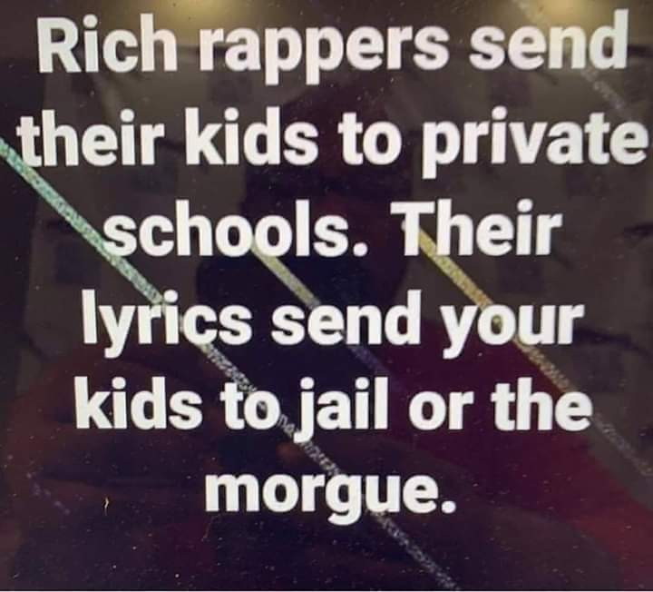
Problem Exercise #1
How many agree with this statement?
How many know how to fix this problem?
What are the mitigating factors?

Slide 10
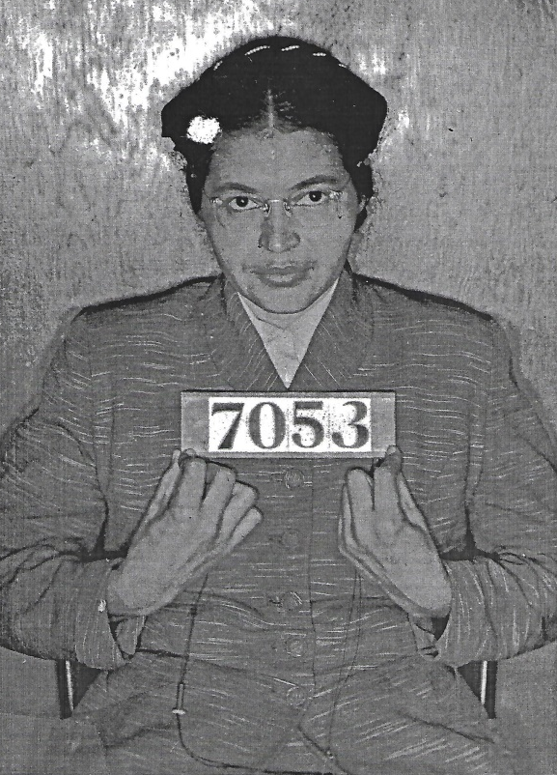
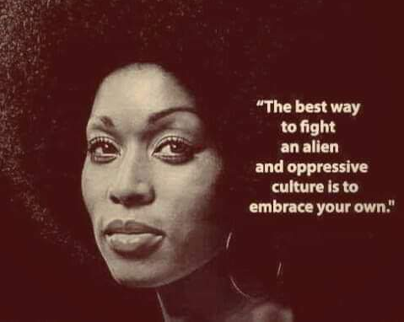
As an American and/or global citizen.
8.

Slide 11
Monolithic Goal #3 - We will move our community towards self-reliance from traditional American culture to creating or redeveloping our own.

Slide 12
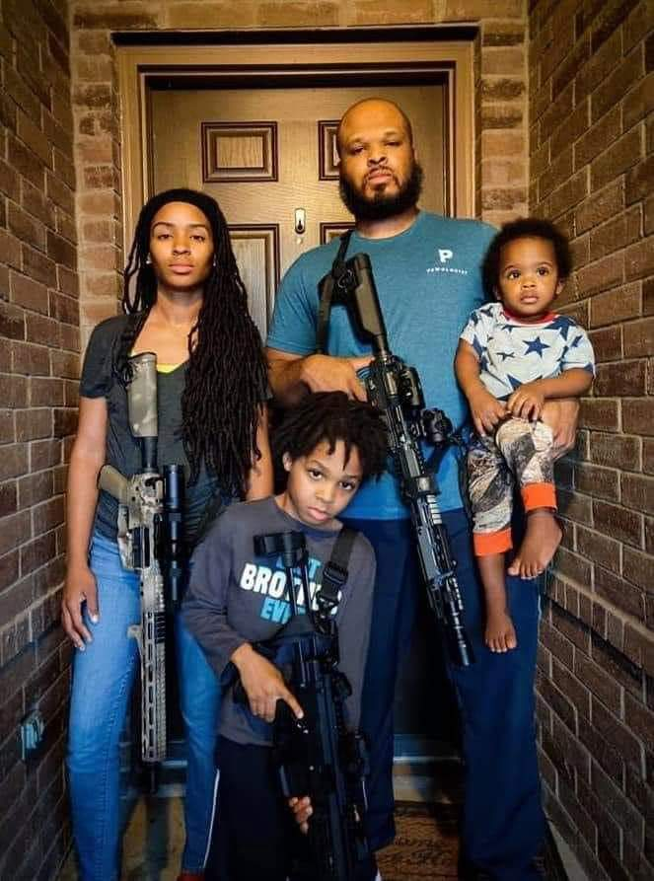
As fathers, family is everything.
As men, what are our duties?
Are there more options to power and protection than through guns?

Slide 13
Politics 101 for the Radical
Politics now
Politics in the future

Slide 14
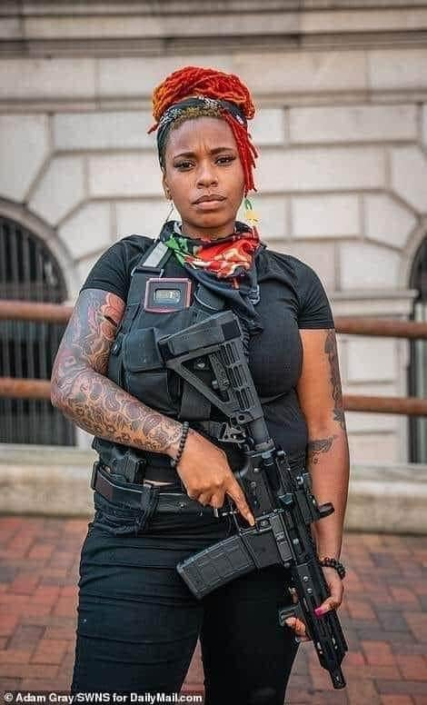
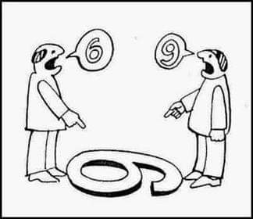
“Logic dictates that the needs of the many outweigh the needs of the few…. or the one.”

Slide 15
Unity Concepts in Culture
Language – (“Heghlu’meH QaQ jajvam,” “Dracarys”)
He glue ma ha Caulk Ja G vaam
Foods – (Franchise, chains, CBD, Bean pie)
Traditions (Courtship, holidays, historical areas sites).
Fashion (FUBU,…..???)
Security (militias, gangs, vs. HOA, neighborhood watch)
Land (RuPaul 60,000 acres, Mineral resources, Flint Water)

Slide 16
Vote
Holding politicians accountable
MONEY

Slide 17
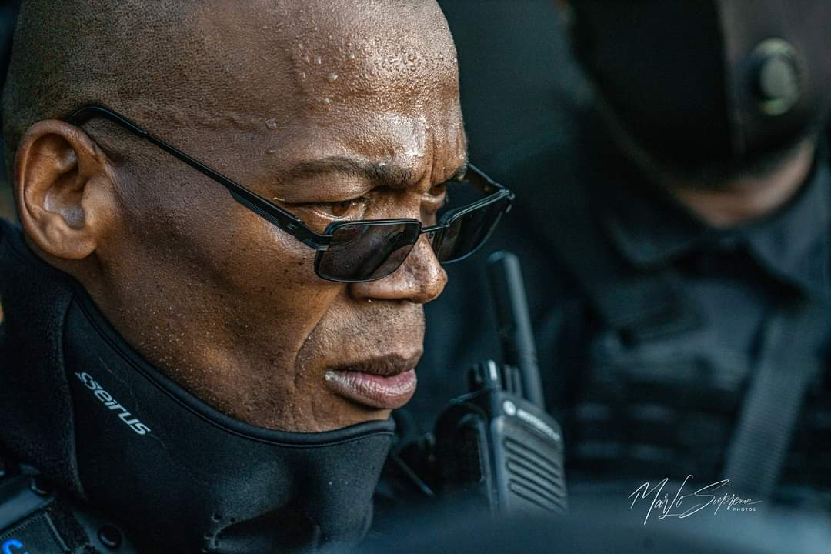
Grand Master Jay ( John Jay Johnson)
NFAC (Not F&#$ Around Coalition)
First to march hundreds of men and women to a Confederate Monument Memorial (Stone Mountain, Georgia) and challenged the KKK to and all out armed confrontation.

Slide 18
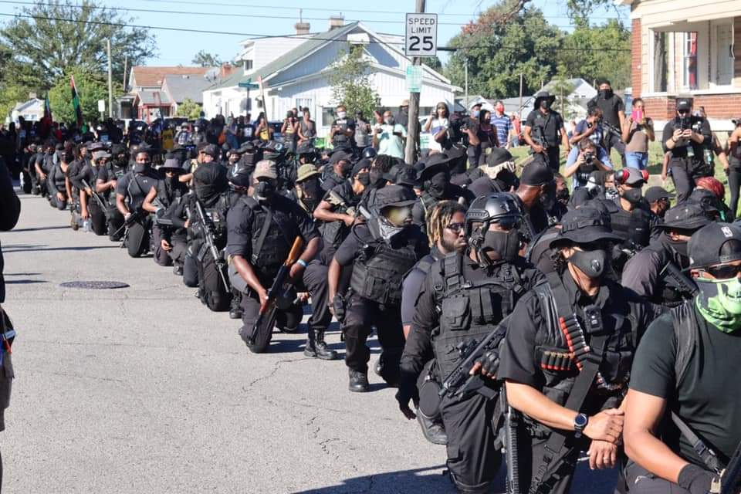

Slide 19
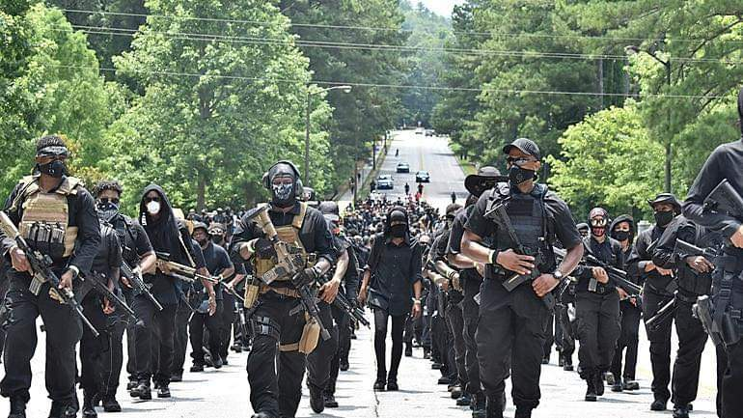

Slide 20
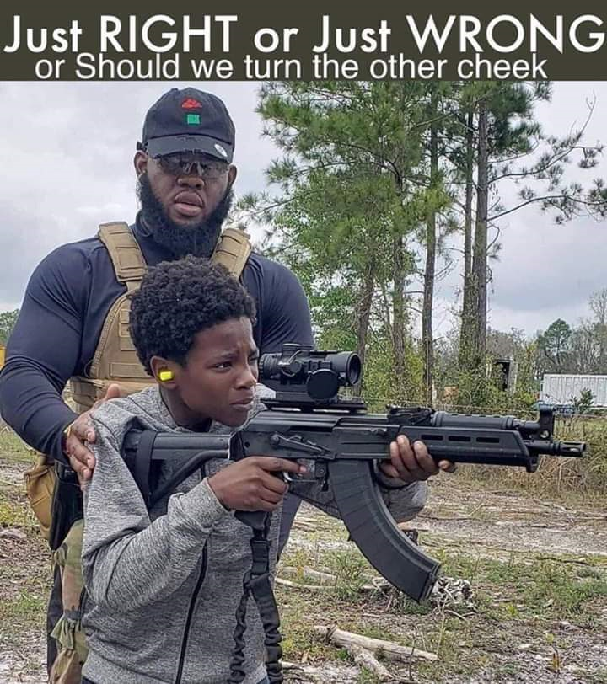
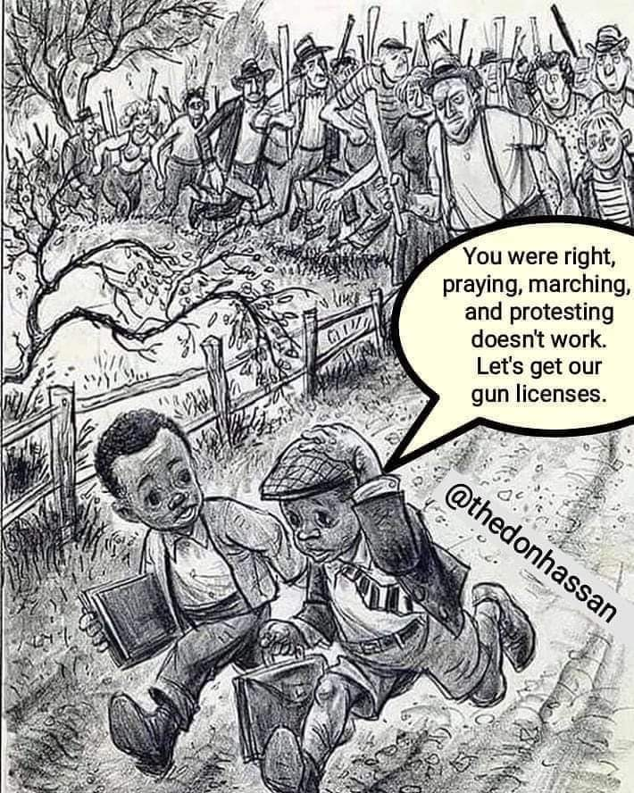

Slide 21
Exercise
Violence vs. non violence
Offense
Defense

Slide 22
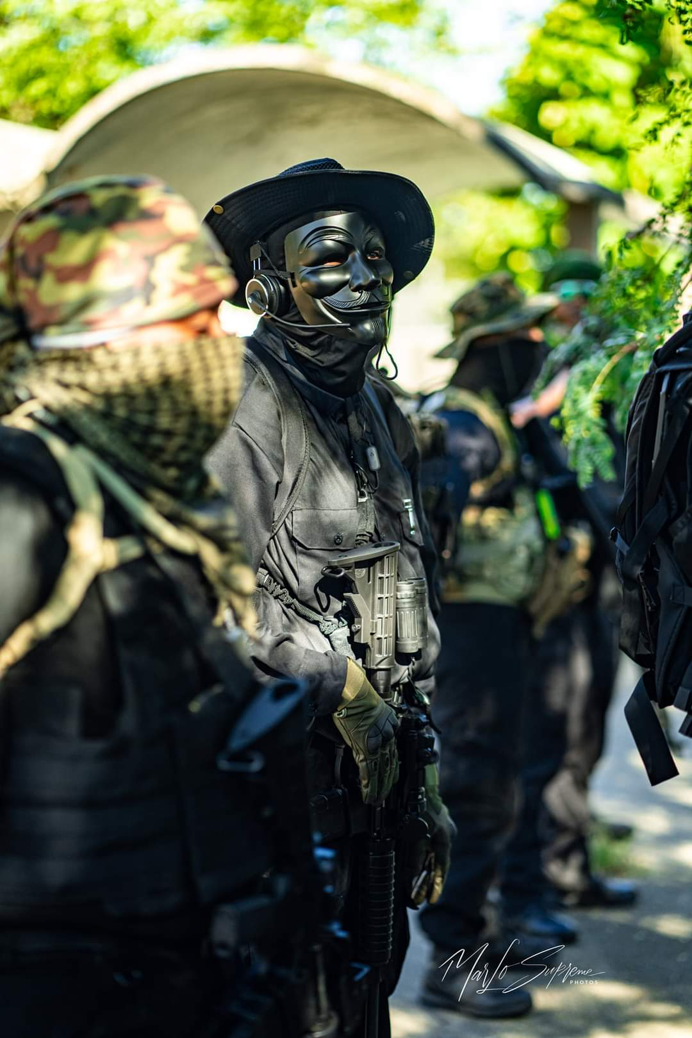
A different mindset is needed….
Society comes before family in the future. As we are today, putting family before everything means if Uncle Joe is a drug dealer, or if my sister cheated her way into an engineering school and is now designing bridges or airplanes, if a con artist becomes president, …. it effects us all. But is it okay?

Slide 23
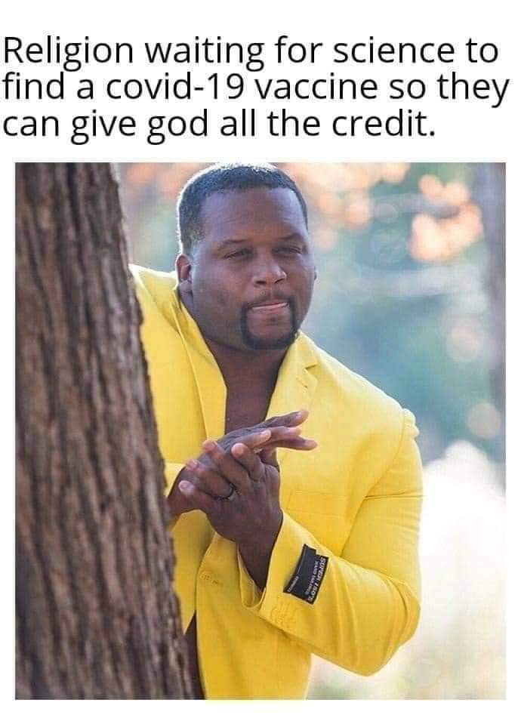
Religion has failed us, but God has kept us alive and will ultimately save us.

Slide 24
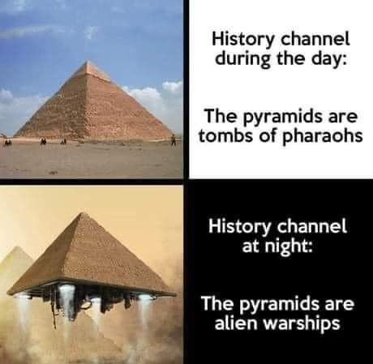
“Life here began out there.”
History
vs.
His-story
23.

Slide 25
Monolithic Goal #1 – We will create our own scientific/spiritual theology based in Ma’at and proven by manifestations from the God within.

Slide 26
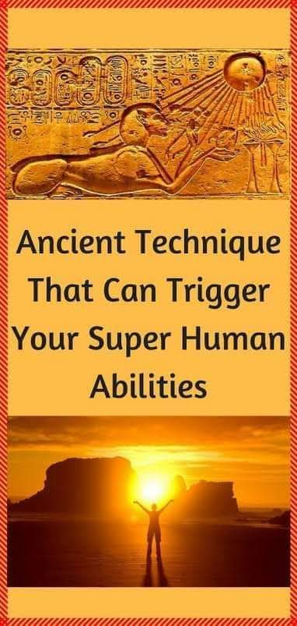
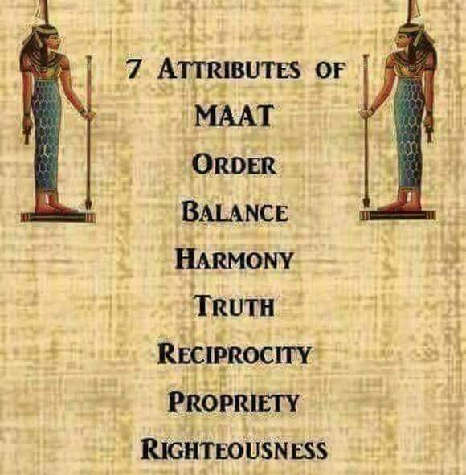
You would not have a divine responsibility without having a divine tool (weapon).
You are the divine weapon.

Slide 27
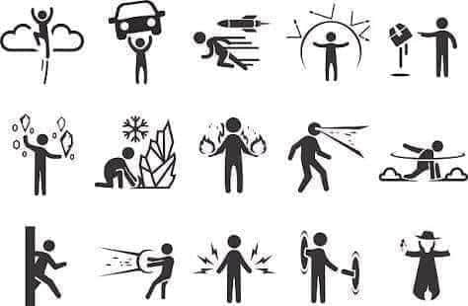

Slide 28
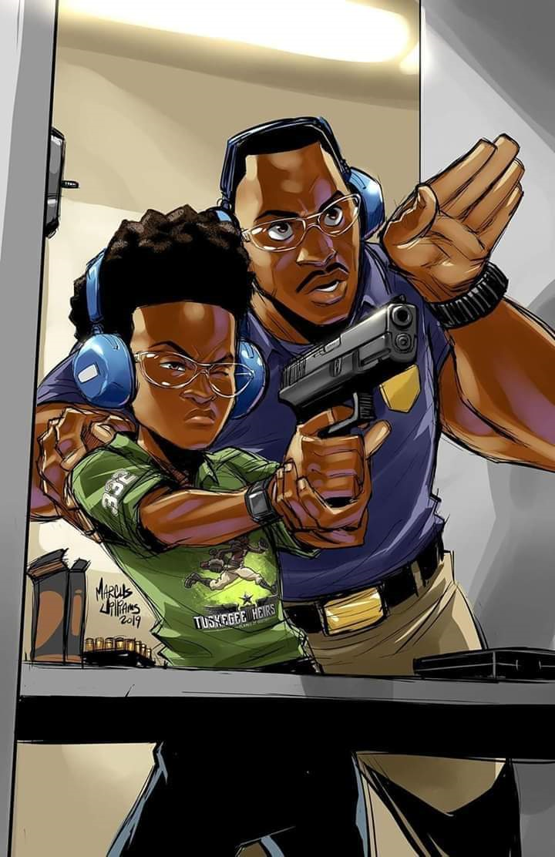

Slide 29
Monolithic Goal #2 –We will create technology, civilization and lifestyles promoting peace, equality, security, and justice.

Slide 30
Warehouse for the community in times of Disaster
Batteries
Toilet paper
Matches
Flashlights
Candles
Bleach
Plastic bags
Tarps
Salt
Propane
Bar B Q grills
Makeshift Hospital

Slide 31
(THIS IS REQUIRED FOR ALL FOOT SOLDIERS AND SUPPORT PERSONNEL OF #NFACTEXAS)
But for now…
MEMORIZE the Miranda Rights
“You have the right to remain silent. Anything you say can and will be used against you in a court of law. You have the right to an attorney. If you cannot afford an attorney, one will be provided for you.”

Slide 32
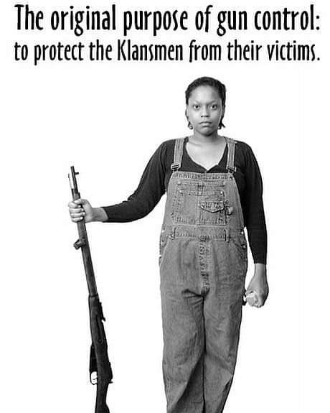
Their Constitution, Our Constitution
You can get a concealed carry license.
You can own a fire arm 1 or 1,000 guns.
You can be a member of NAAGA (NRA or both).
You can join gun clubs and other weapon related organizations.
You can start your own ammunition and gun making companies.
You can have a OneUnited Bank Account.

Slide 33
Monolithic Goal #5- The consumer/producer relationship will be made amenable to both or a new system will be created.

Slide 34
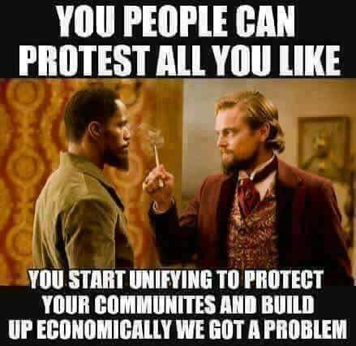

Slide 35
We hope that one day; African Americans can be seen and treated as American citizens. Equality is a part of the #1 monolithic goals. Many Americans embrace this Constitution and would even suggest that this condition of freedom and being American already exists. However, such is not the case en masse, and second-class citizenship status can be easily tested. African Americans understand their condition and treat them appropriately when:
They challenge their authority
Attempt to start or build self-economics
Attempt to increase your wealth, especially collectively
Live in certain areas in America
Bear arms
Retreat from American religious institutions

Slide 36
Monolithic Goal #6- We will take on the status of dual citizenship and create an autonomous nation-state.

Slide 37
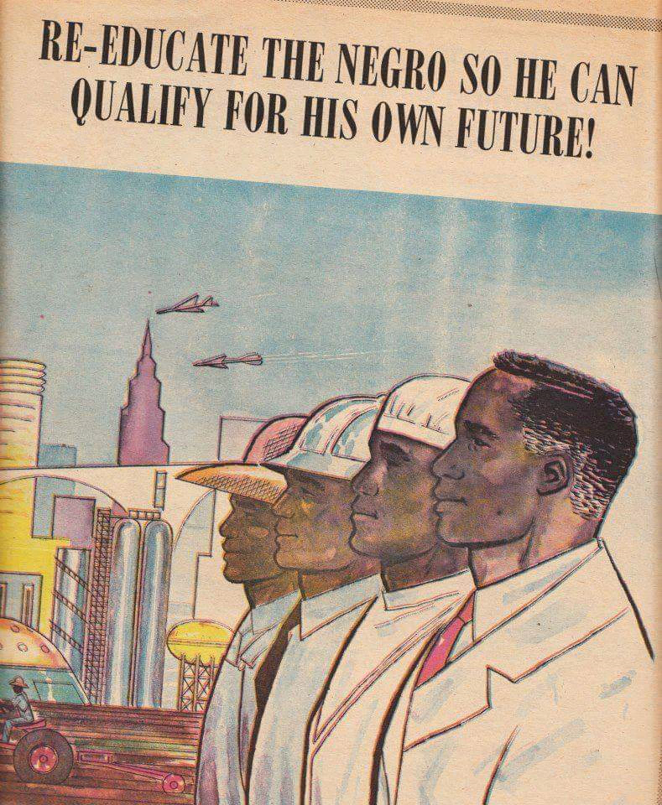
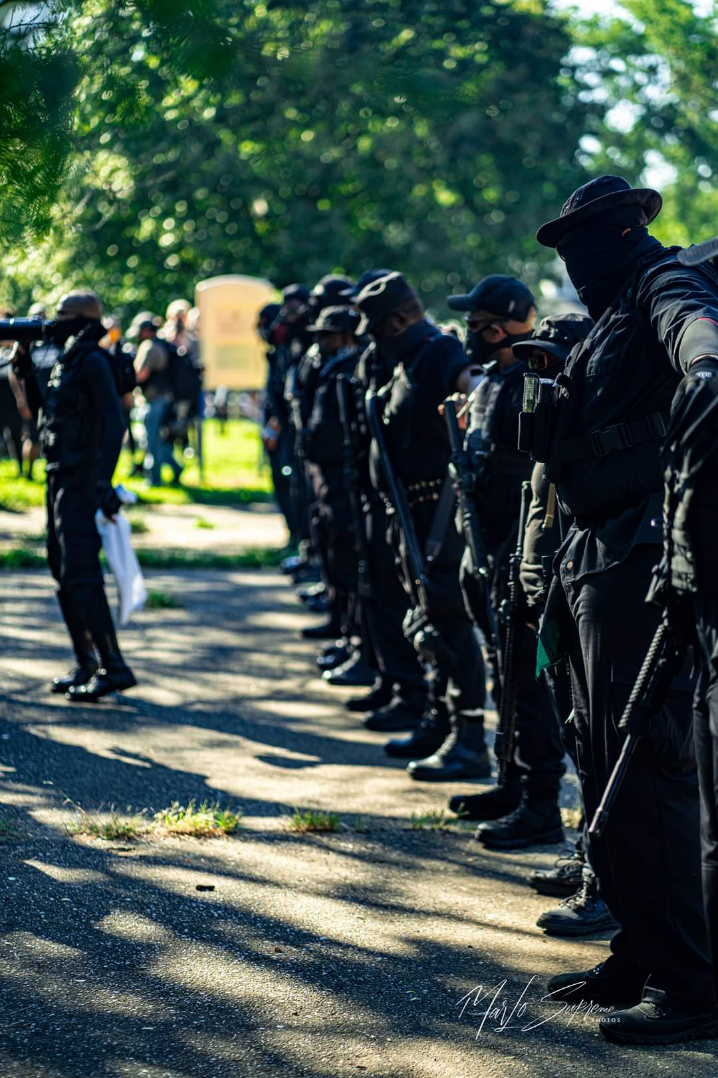
Are we dreaming? Is this a joke?
What are we doing?
Wakanda?

Slide 38
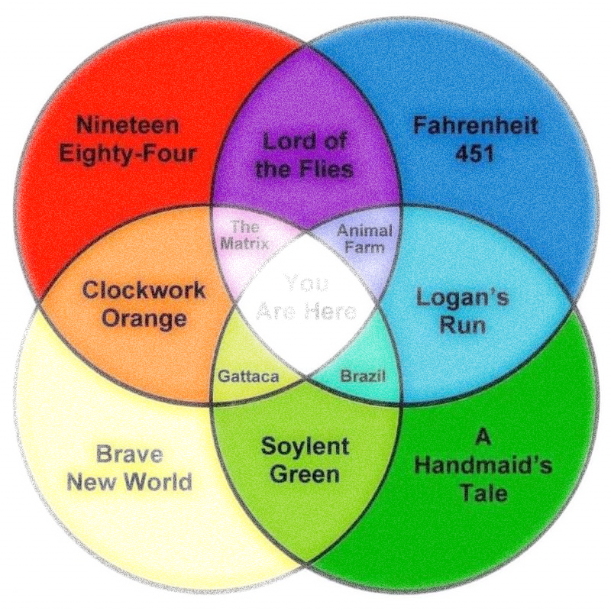
First,…
Where do you think you are going in America?
Where ever they want you to go

Slide 39
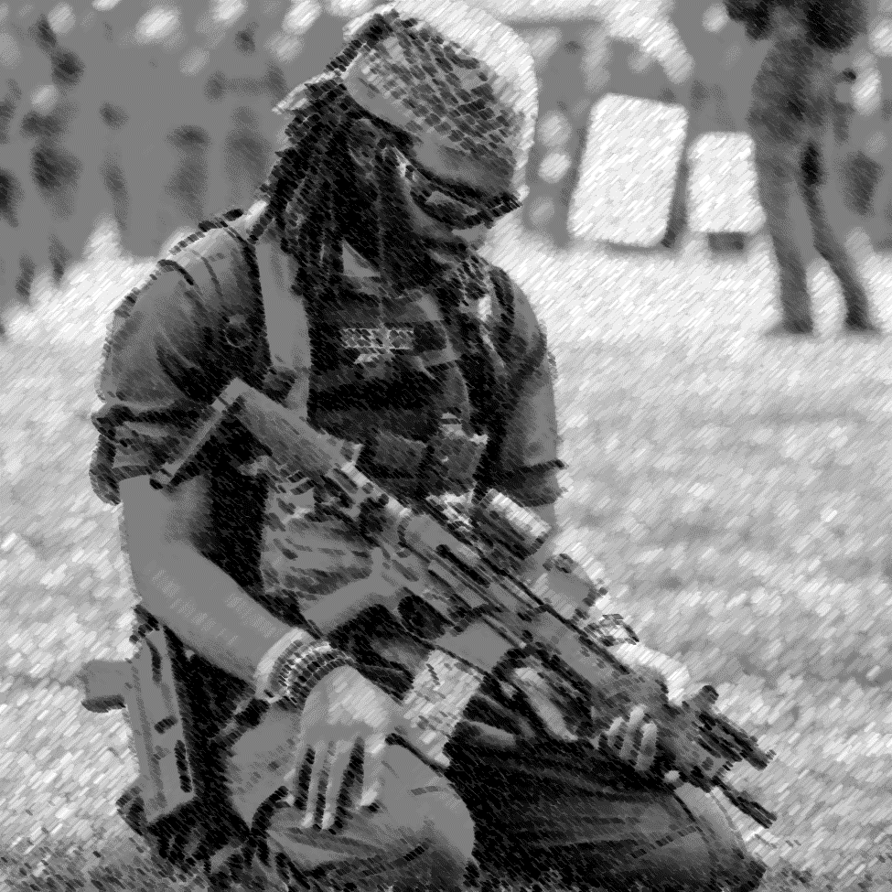
The Way Of The Radical (WOR)
Proposed Evolutionary process of an autonomous area arising within a nation-state.
Multiple self-economic, self-reliance, self-defense grass roots strategies & group acceptance of Monolithic goals. (Unity)
Community Improvement Initiatives & special quorums of leadership & planning.
Dead Mall Projects (DMP) & Steal Away Projects
Independent Import/Export network –South American, African, Networked Economics (S.A.A.N.E.) Consisting of multiple DMP hubs
Settlements & sea steading/Dual citizenship
Nation State/Reparations Space Agency (Status & Activities)
…..and/or be called upon by the president or Congress to protect a state against foreign invasion or attack.

Slide 40
Monolithic Goal #10- African Americans will become space faring people.

Slide 41
Maafa, Slavery to Jim Crow channeled African Americans into certain societal mindsets not inclined to nation building.
Sports
Entertainment
Religion Theology
Food
Water
Housing
Disaster Response
Religion Theology
Clothing
Heat/ Air conditioning
Security
Financial Infrastructure
Space Exploration
Pre–Apocalyptic Training and Preparation
Post–Apocalyptic Training and Preparation
Peace
Justice
Equality
Security

Slide 42
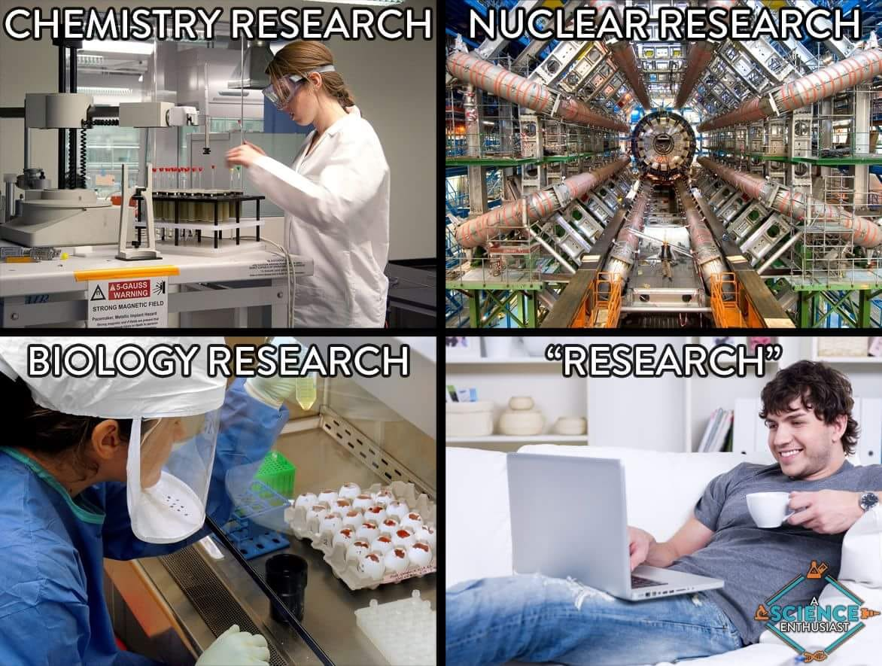
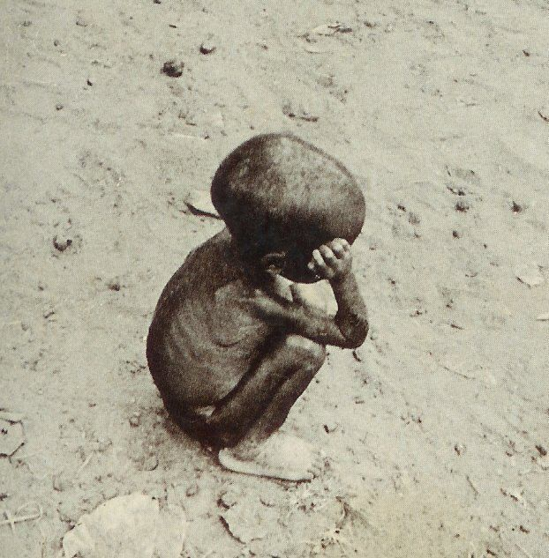
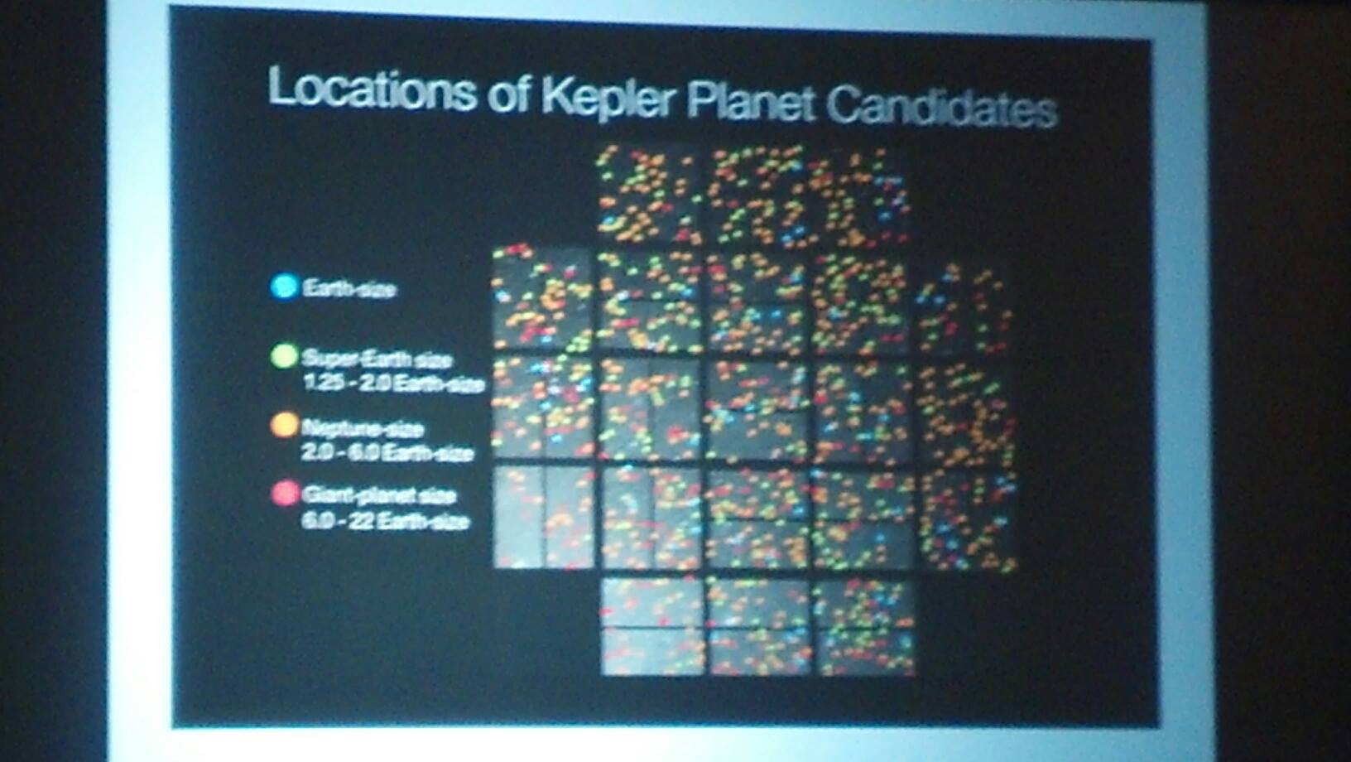
15 minute Break
Come back with thoughts about the future and where YOU want to go.

Slide 43
What ELSE are you Doing in the next 5, 50, 500 years?

Slide 44
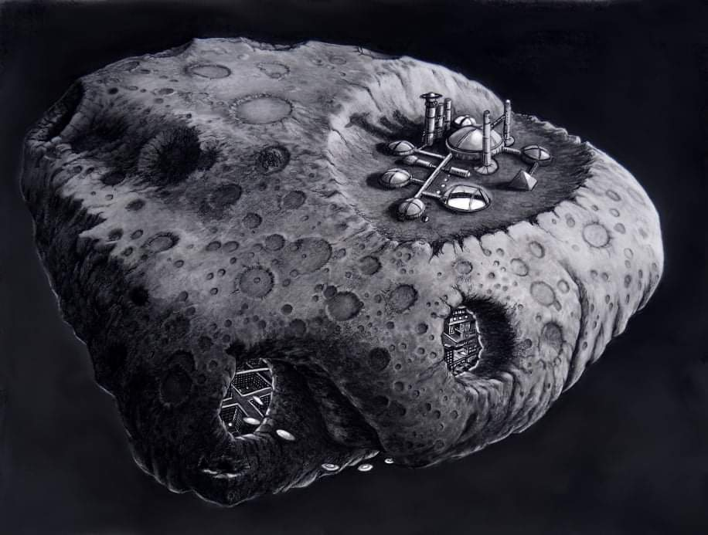
Options?
Try Destiny

Slide 45
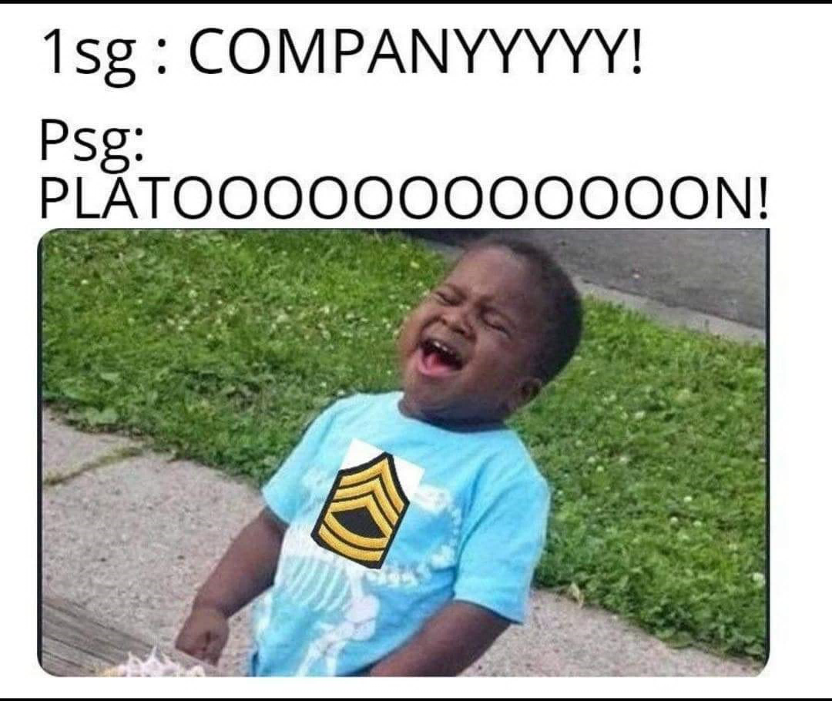
Your mindset Your Individual Skill set Your Money
Knowledge Nugget!
Be willing to attend meetings, training exercises and participate drills

Slide 46
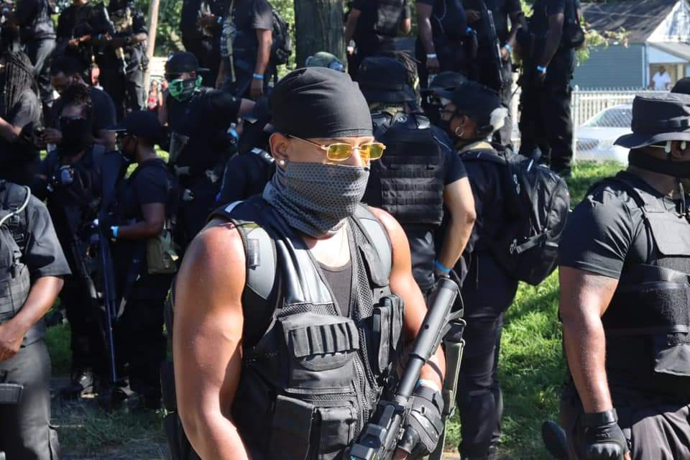

Slide 47
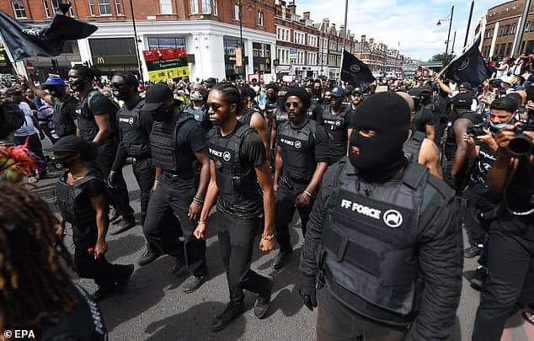

Slide 48
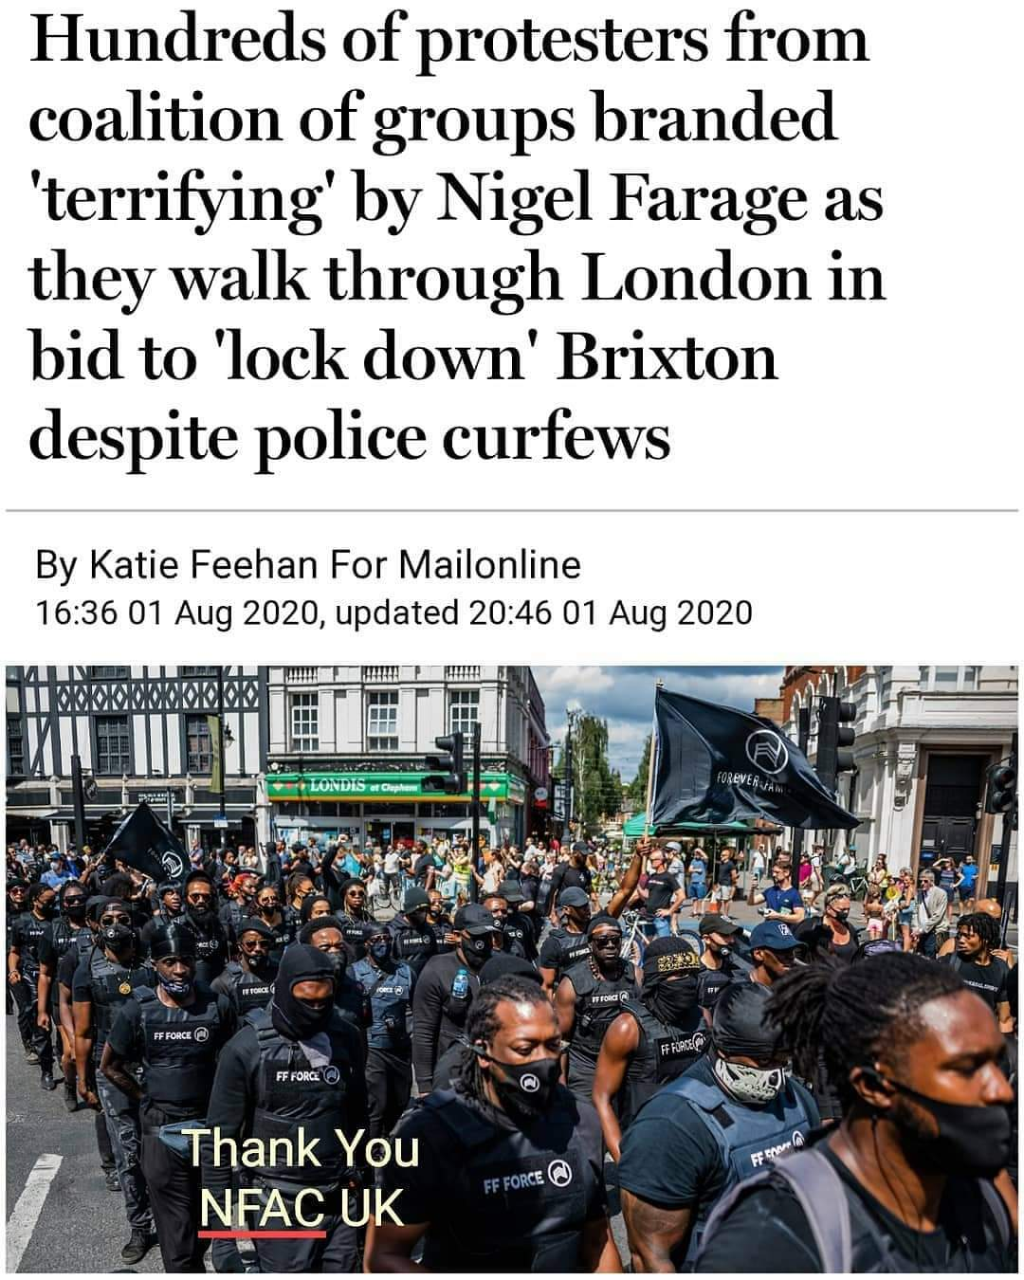
If you think it’s crazy, you join and help keep the sanity! That’s Unity!

Slide 49
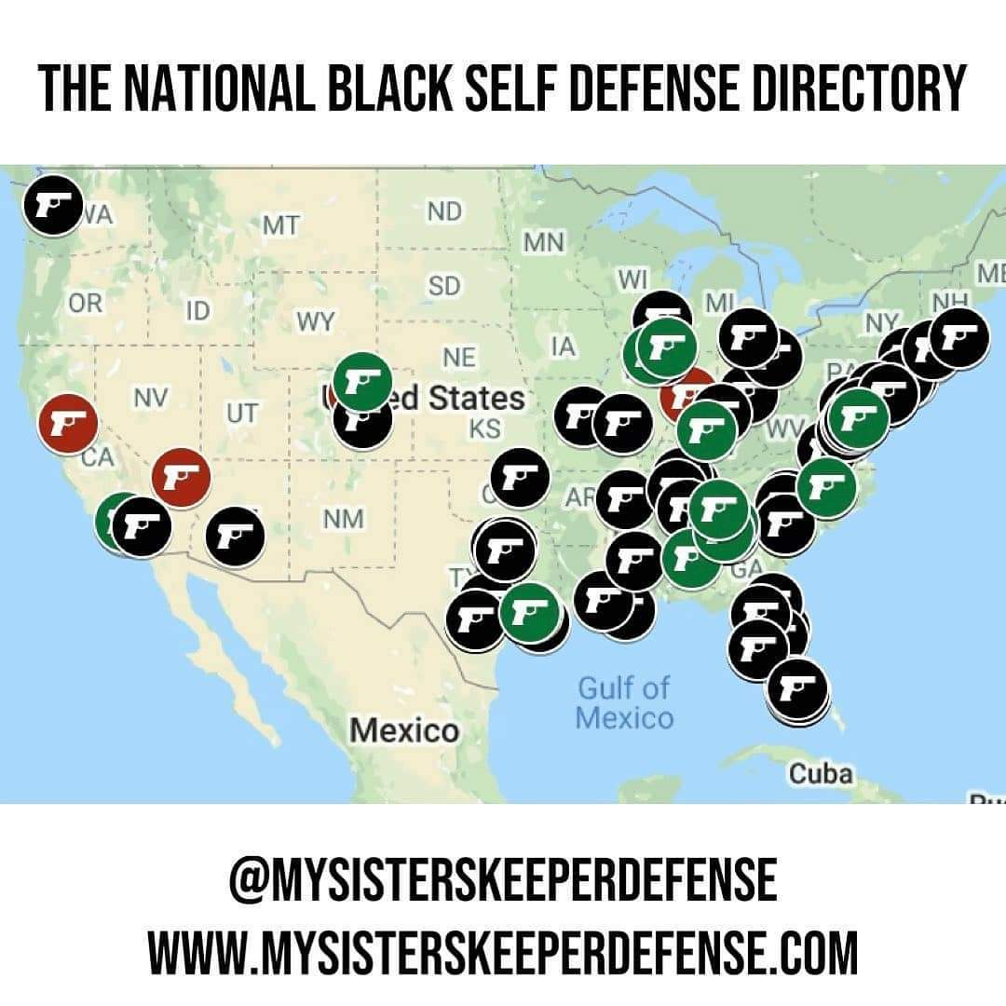

Slide 50
Monolithic Goal # 7- We will return to a holistic science and life style that is good for the planet and people.

Slide 51
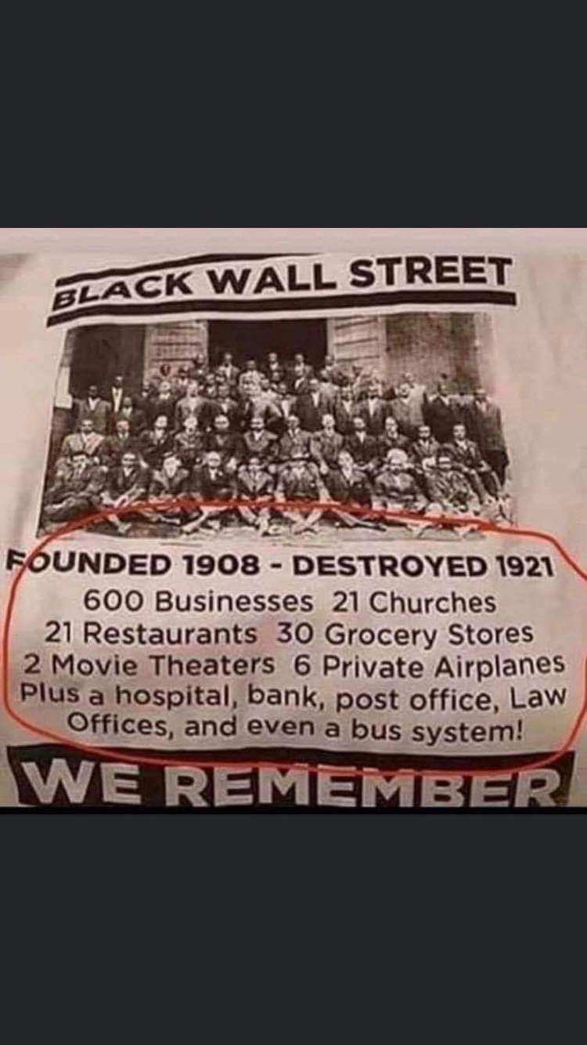

Slide 52
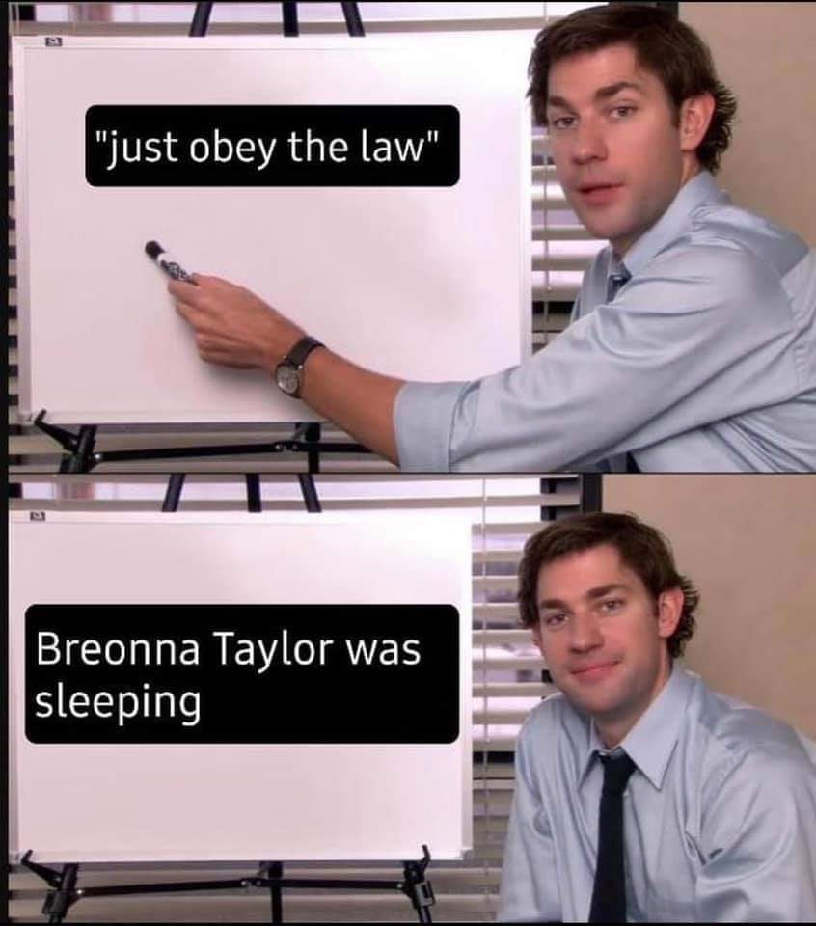

Slide 53
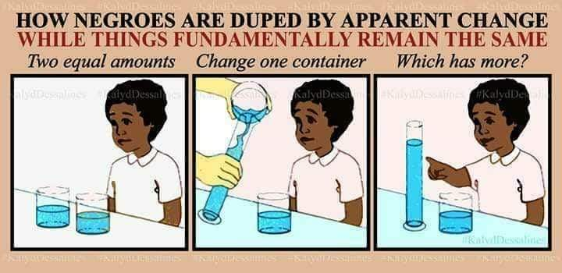
Difference of opinion doesn’t make you an enemy…. IF… you can both agree to monolithic goals.
Those that have bad habits should quit them.

Slide 54
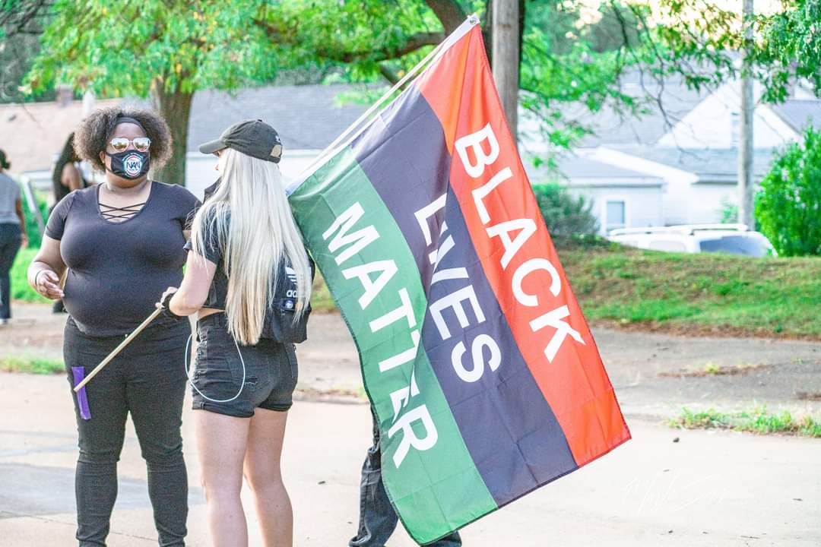
Black Racists?
White Racists?
White Supremacists?
Black Supremacists?
A SYSTEM and the maintainers of that SYSTEM.

Slide 55
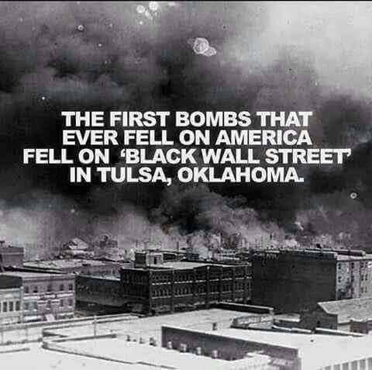
Assessing your threat reality

Slide 56
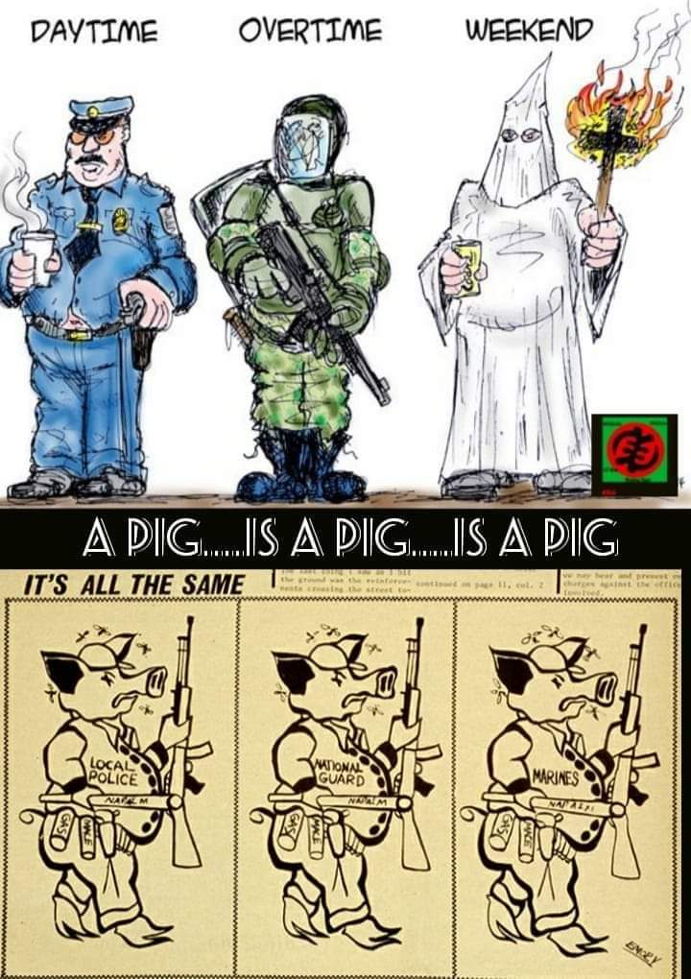
How to end bad cops
Police Departments need better background checks and application process.
Internal affairs requirement to have undercover operations within the department to weed out or closely watch police and “clicks.”
Penalized Police Department through pension funds when settlements are agreed upon, not taxes from the city.
If you have video, wait until police give their version of an incident. Whether they tell the truth or not, then release it to the public.
Robotics, Technology, STEM, Robotics

Slide 57
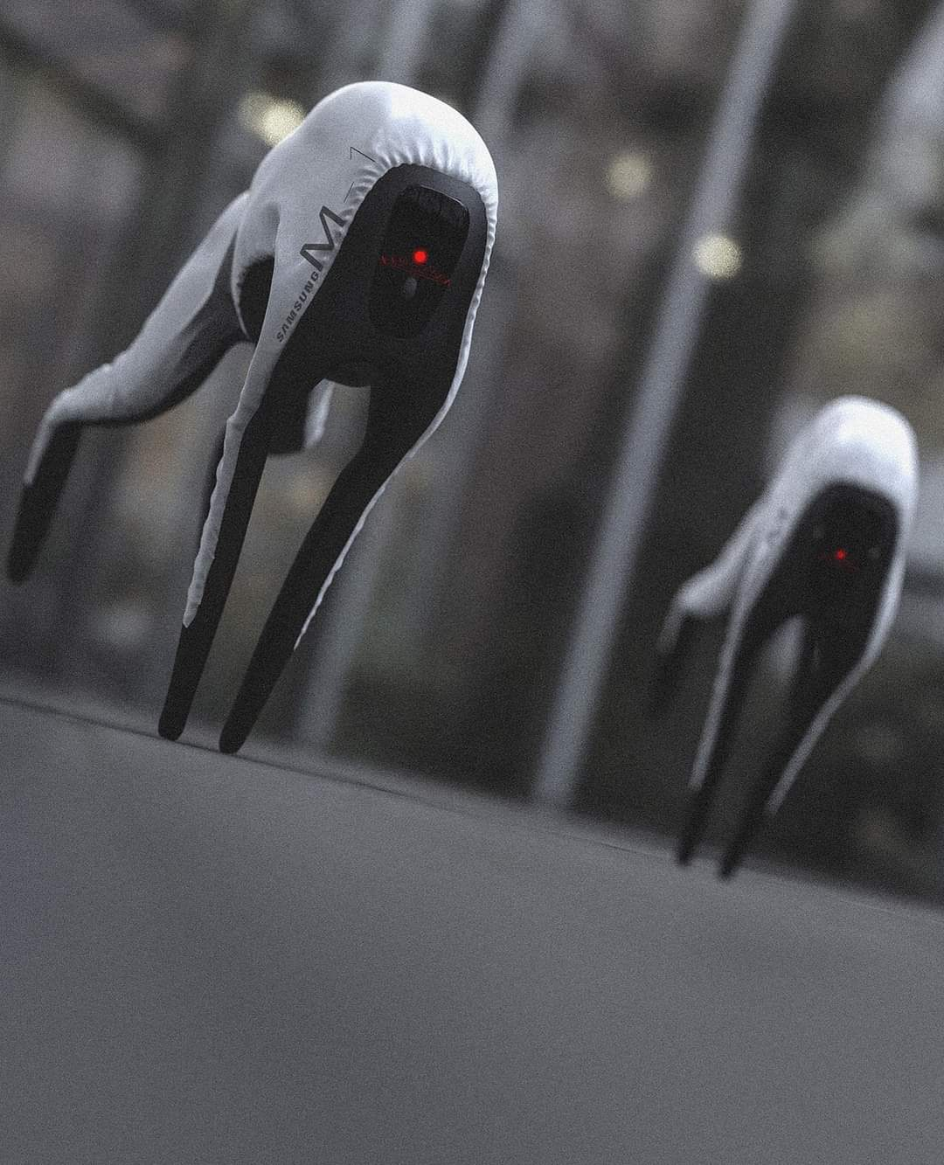
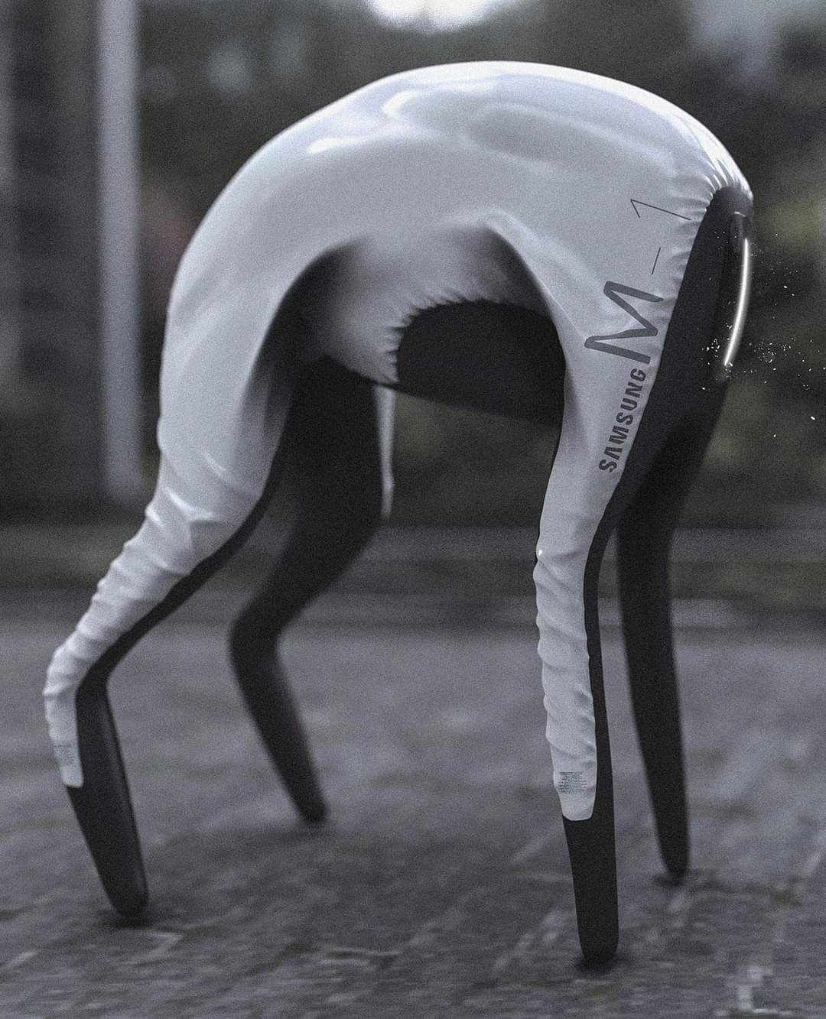

Slide 58
Monolithic goal # 9 -African Americans will continue the American democratic legacy and principles without racism, sexism, and capitalism.

Slide 59
Question | Are blacks Americans equal to other citizens, treated differently? Do black lives matter?
Research | 400 years of it.
Hypothesis | Can African American have a better future if they go and do for self?
Experiment | Create an effective, transparent phased plan to create a nation-state for African Americans as their solution to a better, safer, and brighter future.
Observation | Protest, picket, march, boycott, and things do not change. Start recirculating dollars, purchasing property en masse across Texas, form militias, USA reaction different.
Conclusion | Things change for the better when America realizes African American are deciding to become self-reliant and doing for self. (Battered wife).
Results | Make results public. BE transparent, with missions and objectives made clear to the world.

Slide 60
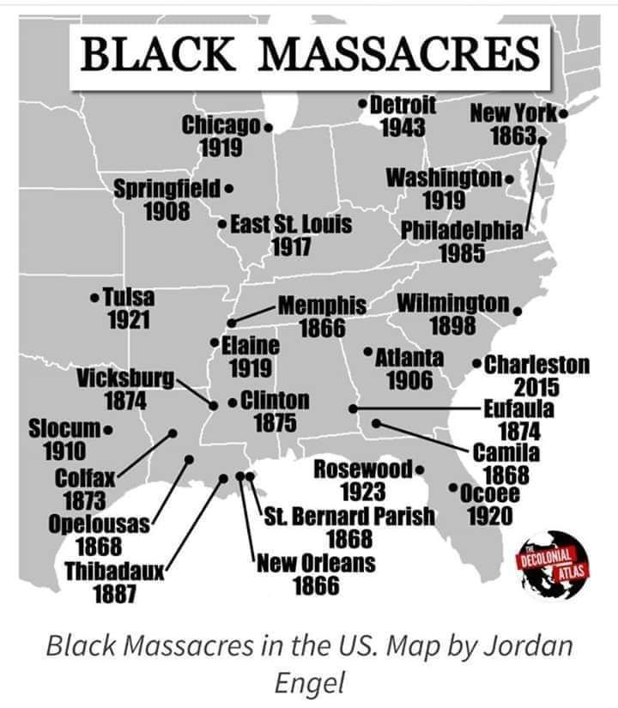
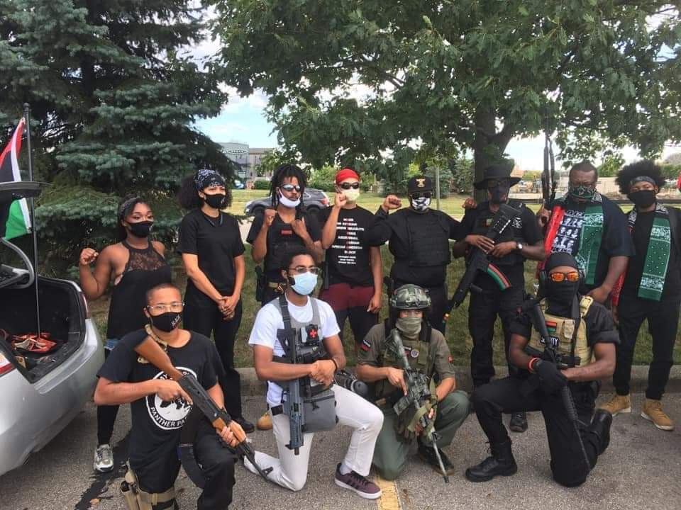

Slide 61
We need unity more than reparations!!
Example—Bloomberg 2016 : The Waggoner Ranch….For 725 million you can buy a Texas ranch 510,527 acres (800 square miles) That’s the size of a small nation. Described as a fixer upper. 1,000 oil wells, 7,000 head of cattle, 30,000 acres of crop land, Water line from Vernon. 800,000 a year. Remember, Alaska, Michigan, Baja California, Georgia, Sea Steading great lakes and more.

Slide 62
Pre–Apocalyptic Training and Preparation
Obey laws & city ordinances/ be the best Global Citizen
Training with medical, fire, gardening, weapons, metal, wood work, voting, community outreach, and international outreach
Green technology and make shift engineering, make shift farming, aquaponics and STEM
VS. (WWORL)
Post–Apocalyptic Training and Preparation
Political Party Pick one to represent or create (Unity)
Paramilitary Security & Fabian strategies & attrition Warfare (Militia)
Dual Citizenship & Global Citizen (Community)
Currency/Bartering

Slide 63
Training the next generation
Pre-Apocalyptic
You will not react immediately, time to train
Post Apocalyptic
You don’t train, time to react, quick response
The minute an individual decides “ rules don’t apply to me,” problems occur. They can even be bad rules, as long as all of society is following, there is continuity.
Businesses are helping our community and not corporate America.

Slide 66
For now….
Be able to legally carry and own your weapons.
2. Complete License to Carry course (LTC).
Physical Requirements
Mental Requirements (Certifications)
Your Gear & tools
Your Personal documents/certifications

Slide 67
Color should not be used to determine friend, foe or family. Character is the key.
Honor
Discipline
Unity
Pride
Planning
Objectives
Goals

Slide 68
Unity Resource Group
Defion Internacional
Triple Canopy
Dyncorp
Erinys International
G4S
Academi
BlackWater
AS Solutions
Gabon de Beckers
Mega Churches?
Executive Protection Work? What’s the difference?

Slide 69
By comparison
Paramilitary
Militia
Employment
Licensed & certified
Insured
Contracts from Government, private sector
Mission (various)
Equipment & weapons (assigned/purchased)
Others?
Paramilitary Army (360,000 global company)
Unemployment
Civilian
Volunteer security/protests
Mission (various)
Equipment & weapons ( self assigned/purchased)
Others?
700, 800? Security Rescue Teams

Slide 70
Permits
Insurance
Licenses
__________
Million dollar contracts
Security
Community/Global
Committed to YOUR needs
Build Brand Equity
Who we are
What we do
Why we exist

Slide 72
Bar B Q
Cooking by Camp Fire
Electronics
Map Reading
Compass
Sharp edge weapons
Firearms
Chemistry
Gardening
First Aid
Telephony
Boating

Slide 73
Community improvement, DMPs, S.A.N.E., Settlements & Nation building.
South American, African, Networked Economics (S.A.A.N.E.) The need for protection?

Slide 74
A militia with 10 Acres of land

Slide 75
Knowledge Nugget!
Remember the movie 2012? When a real disaster comes, it is the people (lives) that are important.
A militia with 100 Acres of land

Slide 76
A militia with 10,000 acres of land
Locations and Properties of the Militia
Mission Control
Firing Range (Outdoor/Indoor)
Close quarter Combat training facility/Area
Meeting place Public/Private
Clandestine meet up location(s)
Safe house (network) reaching abroad
Sanctuary
Motor Pool & auto shop
Non tower Airfield
Farm land
Settlement territory/ Large Compound

Slide 77
Militia Names
Gun Club | Community Quality Assurance Committee | Protectors
Citizen Defense League | Guardians/Sentinels | Texican
Shooting Enthusiasts | Horde/Raider | Texas
Shooting Academy | Shield | Lone Star
Legion/Coalition | Saviors/Peacekeepers | State, City, County, Neighborhood
Tribe | Faction | Community

Slide 78
As beautiful or frightening as this is, it will get old….

Slide 79
Purpose is defined by….. destiny and desire

Slide 80
Pathway for the CommUnity Prepper
1. Dual citizenship
2. Global Citizen Party
3. Special forum to create voting process to determine what land(s)/Seas can be settled on.
4. Paramilitary Security force
5. DMP hubs/nationally
6.Settlements
7. African Space Agency
An
agenda
for all.

Slide 81
Time to decide….
Revolution or Renaissance??
Build
or
Destroy

Slide 84
Imagine a world recreated
Schools
Energy
Housing
Food Production
Business
Work Place

Slide 85
Forget Reparations. Can you make it happen?
1 Acre
Modern Cargo Container 2000 sq ft. House under 55,000
Solar panel system (free electricity)
Rain collection system (free water)

Slide 86
Launch
Mars is a 7 month trip, approx. 39 million miles
Land
Portable Oxygen Generators
Portable Water Filter
Plants & seeds
Solar Power kits
Drone & robotics
Clothing
Communications
Medical
Transportation
3D printing

Slide 87
10. Solar Electric Company
9. Sesame Street Broadcast Studio
8. Stun Gun Company
7. Submersible Cruise & tourist Company
6. Satellite Company
5. Our Facebook
4. Robotics Company
3. Pharmaceutical Industry
2. Psychic/Religious Intuitions
1. Land development company

Slide 90
Montevideo Convention Rights & Duties of States (1933).
Declare independence ( intentions) usually involves showing a clearly defined territory.
Gain recognition G.H.O.S.T.
Join United Nations

Slide 97
The end of this world, is the beginning of ours

Slide 98
Monolithic Goals For the African American
Monolithic Goal #1 – African Americans will create their own scientific/spiritual theology based in Ma’at and proven by manifestations from the God within.
Monolithic Goal #2 –We will create technology, civilization and lifestyles promoting peace, equality, security, and justice.
Monolithic Goal #3 - We will Move our population towards self-reliance from traditional American culture to creating or redeveloping our own.
Monolithic Goal #4 – Create new entertainment concepts that are compatible with our reality and destiny.
Monolithic Goal #5- The consumer/producer relationship will be made amenable to both or a new system will be created.
Monolithic Goal #6- We will take on the status of dual citizenship and create an autonomous nation-state.
Monolithic Goal #7-African Americans will return to a holistic science that is good for the planet and people.
Monolithic Goal #8- African Americans will move to create a Space Industrial Complex.
Monolithic Goal #9- African Americans will continue the American democratic legacy and principles without racism, sexism, and capitalism.
Monolithic Goal #10- African Americans will become space faring people.

Slide 99
Questions?

