Slide 1
Introducing Music, Man and the Mind Deprogramming of the Negro Series
www.corenovus.org
Notes:
This presentation demonstrates the new capabilities of PowerPoint and it is best viewed in Slide Show. These slides are designed to give you great ideas for the presentations you’ll create in PowerPoint 2010!
For more sample templates, click the File tab, and then on the New tab, click Sample Templates.

Slide 2
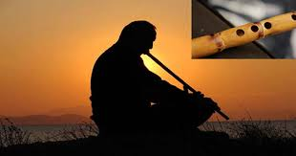
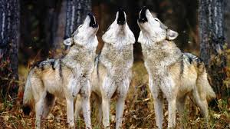
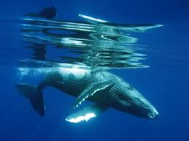
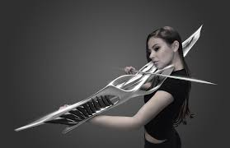
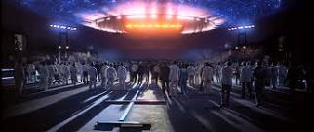
What is Music?
Sounds: These are profound ways of communication within nature using sound (Music).
Animals, the songs of birds, dolphins and whales allow transmission and reception process.
Some have suggested that it could assist humanity with speaking to off world intelligence.

Slide 3
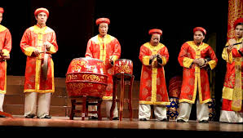
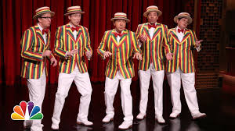
Music is a natural, human and social phenomenon.

Slide 4
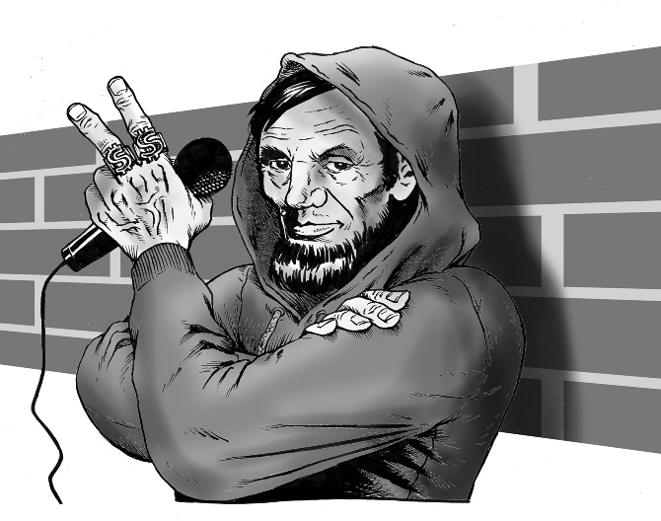
The human brain has been wired to recognize and organize sounds into rhythmic patterns.
Some sounds can touch our very psyche. We know, “that is my jam,” and 50 million other people can agree with you.
But making it in the music industry is a challenging/ lucrative business for the artist.
Going platinum and so forth through history, a star is born and that becomes the goal & objective. Nothing else really matters? How far will you go?
Also, for the audience, what is the cause and effect of your fortune and talent?
“Nearly all men can stand adversity, but if you want to test a man's character, give him power.”
― Abraham Lincoln

Slide 5
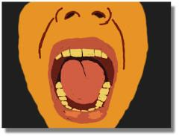
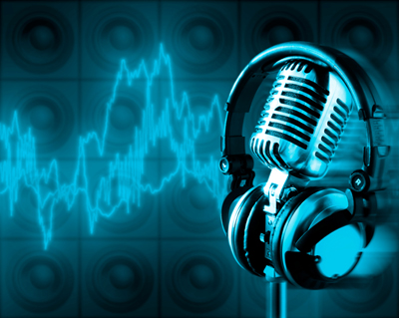
Sound
Music (Sound) interacts with our minds, and our minds make music. It is very important to have the right mindset to make music because it will affect you and others that listen to it. It is intended to affect you. To make you move, cry, dance…. The brain has neuronal circuits and endogenous substances.

Slide 6
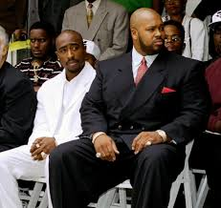
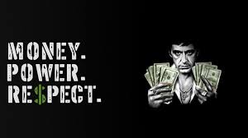
There are types of music when played, soul, R&B, Blues, jazz, gospel, classical they can caress that part of us, massage it like any other powerful emotion such as love, sorrow, anger and passion from another being.…
….And there is also Rap! (Hip Hop).

Slide 7
But wait, before you agree or disagree ….CONSIDER THE SCIENCE (the Core Novus way). What is the science of music? Two points….
Whether it is the beat of instruments that are eons old like the drum or a Pulsar millions of light years away. Whether is the whistling sound of the flute or the wind through patio chimes, sound exists in reality to be heard by us and perceived. It is to be manipulated in our minds. Sounds, coherent tones, notes, chords, and sometimes even simple static noise can become music if a pattern is recognizable.
With the use of spatial organization, timing, sequence and beat, humans can connect with the universe and there is nothing spooky about it. Remember, we are really talking about vibrations of air reaching our ears and with a penetrating effect, deciphered in the minds.

Slide 8
Music and the Mind
http://jonlieffmd.com/blog/music-training-and-neuroplasticity
What does Science say about this? ?
What does the Soul say about this?
What do you say about this?

Slide 9
The power is psychological. The “value” must be challenged or accepted to be imprinted as culture.
(Power Point Place holder)
©2017 www.CoreNovus.org

Slide 10
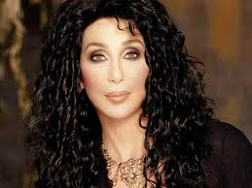
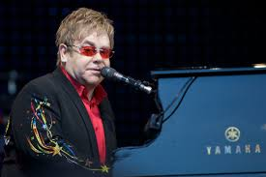
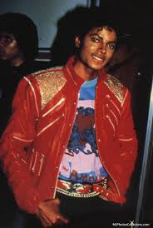
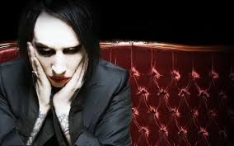
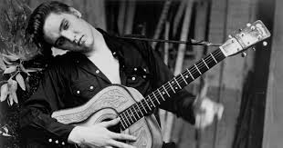
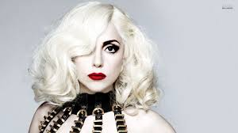
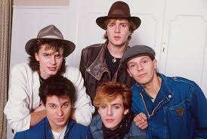
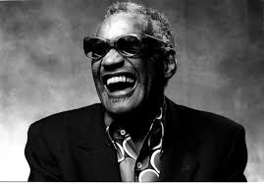
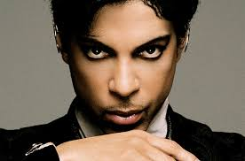
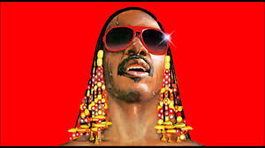
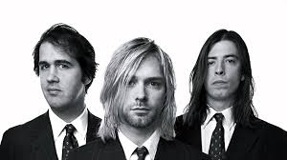
In society, music intertwines with culture, influences fashion, creates role models and standards of beauty. Music can reflect society as a whole.

Slide 12
Hand out exercise Page 2
©2017 www.CoreNovus.org
1000 year old music/Fads and One hit wonders

Slide 13
Sounds can be heard anywhere in the universe, including the vacuum of space. Science tells us that the unborn can be effected by music. So, even in the womb, before one comes into existence, sound can be heard.

Slide 14
Types of Rap
The Genre of Rap, Gangsta, R&B, Jazz, Pop, and many others are considered music with soul and rhythm of the “African” persuasion.
(Wikipedia) a list of rap styles
Historical time periods
Roots of hip hop
Old school hip hop
New school hip hop
Golden age hip hop
Derived styles
Alternative hip hop
Avant-garde hip hop
Breakbeat1
Britcore
Boom bap
Chap hop6
Chopped and screwed
Chopper
Christian hip hop
Comedy hip hop
Contemporary R&B
Conscious hip hop
Country-rap
Crunk
Crunkcore4
Crunk-Hop
Cloud rap
Drill
Electro hop1
Experimental hip hop
Freestyle rap
G-funk
Gangsta rap
Ghetto house1
Ghettotech1
Glitch hop1
Grime1
Hardcore hip hop
Hip hop soul3
Hip house1
Horrorcore
Hyphy
Industrial hip hop
Instrumental hip hop
Jazz rap
Jersey club
Low Bap
Lyrical hip hop
Mafioso rap
Mobb
Nerdcore hip hop
Neurohop
New jack swing
Political hip hop
Pop-rap1
Porno rap
Ragga hip hop5
Rap opera
Rap rave
Rap rock
Rapcore4
Rap metal
Salamax Hip Hop
Snap music
Modern Club Hip Hop
Mumble Rap
Stronda music
Swing Hip Hop
Trap
Trip hop1 4
Turntablism
Underground hip hop
Urban Pasifika5

Slide 15
Hand out exercise Page 5
©2017 www.CoreNovus.org
The Rapper, the Rap and Expression

Slide 16
Thus, music can prepare for war or make us hug it out in peace.
A music meant for one thing which is clear, the continuing push or glorification of capitalism, illegitimate business, violence, anarchy, and sexual innuendo.
DANGER!! DANGER!! WILL ROBINSON!

Slide 17
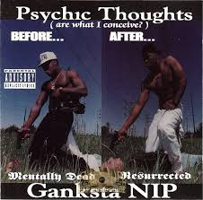
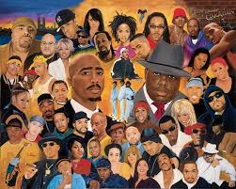
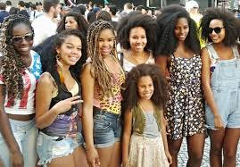
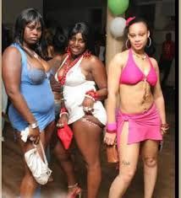
The true Conscious attitude…….Blah, blah, blah blah…..
But it can change your language, your vocabulary, your dress; it can give you life long beliefs and ideas.
How does this fall away?
…And this doesn’t?
“ The devil whispered into my ear… You are not strong enough to with stand the storm.” Today I whispered into the Devil’s ear… “ I am the storm. “ ` Anonymous.

Slide 18
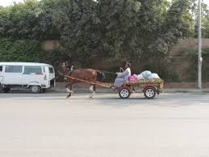
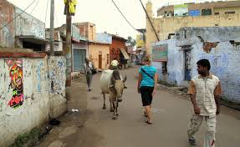
World to the rapper,…. Gangsta rap made you do it? Life in the streets hard? It’s bad all over the world, get over yourself!
Not a street thing, not a poor thing, not a black thing…..

Slide 19
(Power Point Place Holder)
For details to the entire Power Point, workshop, prices,
dates and times, please send all inquires to
corenovus@gmail.com
©2017 www.CoreNovus.org

Slide 20
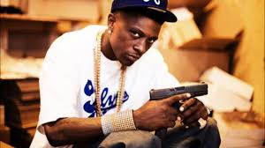
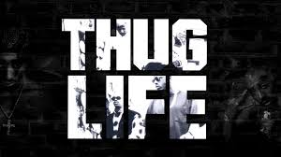
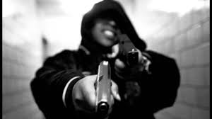
With music, there’s culture. Change the Music? Change the Culture?
….Our music is NOT the problem. The associated “thug life” images is. It should not have anything to do with our culture. It has nothing to do with musical talent or skill.
Glamorization and promotion of violence is NOT OUR culture and although it exists in society, doesn’t need to be in our music. Absolutely no justification.

Slide 21
(PowerPoint Place Holder)
For details to the entire Power Point, workshop, prices, dates and times, please send all inquires to
corenovus@gmail.com
©2017 www.CoreNovus.org

Slide 22
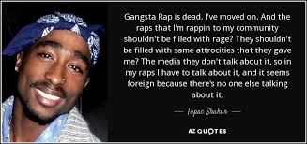
Stimulus
Positive reinforcement
Negative reinforcement
Consequences effect the behavior
With behavior, there are consequences.

Slide 23
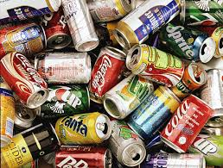
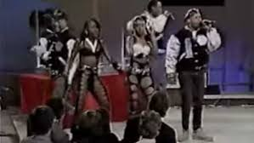
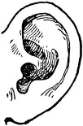
New standard of music is needed, not Thought Police….. If YOU can manage yourself. “A new type of Musician/Rapper”
This recycling is good.
This recycling?
Not so good

Slide 24
To establish a New Core individually and within the community, a zero tolerance can be created OR the Conscious Community set the example.
The Conscious Rapper
Must choose to (when creating music):
To not glamorize criminal, gang, or thug lifestyles or portray them as a positive and/or “black.”
Do not use your platform of talent to talk negatively about other artists, degrade women, push illegitimate business, etc. (It’s music, entertain).
Move away from “get rich or die tryin mentality.” Strive for success.
You can create rap without curse words and still express yourself IF you have true talent.
You can create rap/music without using the nword and still express yourself IF you have true talent.

Slide 25
The Conscious Audience (Consumer)
Must choose to (when listening to music):
NOT to purchase music that targets criminal, gang or thug lifestyles and portrays them as a positive and/or “black.”
NOT to support, listen or purchase music that degrades women, glorifies violence, etc.
We can support rap and music without curse words.
We can support rap/music without the usage of the nword.
Not to give air time, interviews, etc.
This is only a starting point

Slide 26
Of course it will stop, several ways….
Political Action/Legislation
Ultimately,
YOU
the artist and
YOU
the audience.
Education/Spiritual awareness
Take Black Back

Slide 27
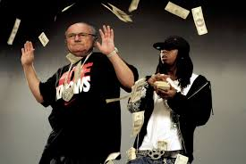
Garbage in, Garbage out….money in, money out
?

Slide 28
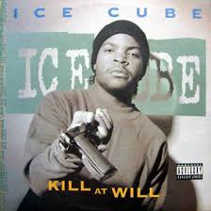
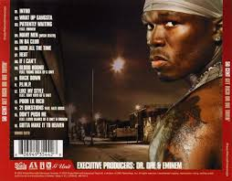
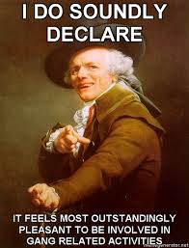
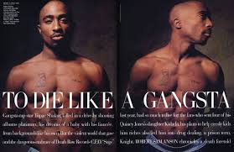
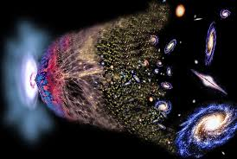
Remember This?

Slide 29
Garbage in, Garbage out….money in, money out
The repeating cycle must be broken
Easiest way to break the cycle, hear filth, reject it…. Monetarily.

Slide 30
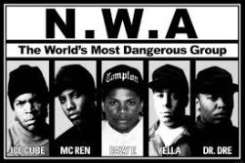
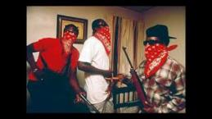
No youth is going to need a parent to explain why they should or should not be listening to a certain type of music. They will listen either with or with out your knowledge if the child likes the music. Thus, the question….what attracts the youth to this music?
Should there parents be worried about the music they listen too? Is it too little to late? What exactly should the parents say?
Too late and to little??

Slide 31
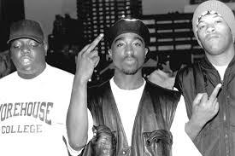
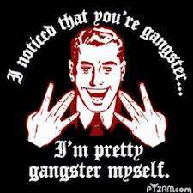
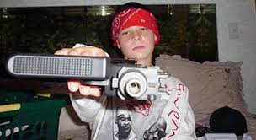
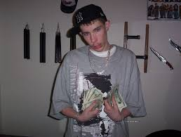
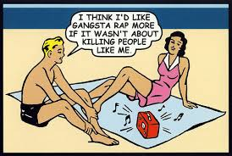
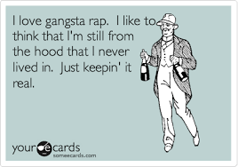
This world’s solution…. containment.

Slide 32
Hand out exercise Page 8
©2017 www.CoreNovus.org
Emotions, Brain and Music

Slide 33
FRUIT – Functional Recognition of (a) Universal Intelligence Theory (lowest form of believing in the One God….at least).
If humans are slightly connected to a divinity (a Supreme Being), that established connection is internalize in our psyche, and our essence.
That connection is made in what can be best described as a soul.
Ego
Self Id
How to raise self Esteem?
When the increase of a challenge occurs, no mercy, no chance, no gifts, no answered prayers, through will and the Mercy of God, you win.
All we ask as a community is that you bear fruit through your music!

Slide 34
Hand Out Exercise Two Page 8
©2017 www.CoreNovus.org
Lyric substitution

Slide 35
Reminder Points on de-masculation and the Industry
Sex --dichotomous – You are neither or both
Your Chromosomes determine if you are a MAN or a WOMAN, period.
Gender can be masculine or feminine. These are roles you play. Traditional or non-traditional.
One choses to be gay, at the same time this is no reason to hate.
Accept others as they are.
Let science be the a guide, let your religion be in your heart.

Slide 36
Music is a force
The melodies and notes entertain us, but it is our brains that seek patterns and translates it into a rhythm.
It’s effect on the human brain is scientifically proven. (Mozart Effect)
What happens when songs get stuck in your head?
What's the difference between a crowd listening to music and a crowd listening to a brilliant speaker?

Slide 37
HAND OUT Exercise Page 13
©2017 www.CoreNovus.org
The Challenge of Creative Change

Slide 38
We can do this! Music that the family can listen to.
Remember,….Your babies are special. Over time, parent’s effect over the child lessens and peers take over.
Locus of control

Slide 39
DEMAND IT AND RESIST
The Hidden Hints
Mayhem from a gangster mentality and madness for money is entertainment? Really?
This problem is obvious and simple as its primary function, intentional or not, is to degrade a beautiful people.
It is not worthy of an advance civilized people or a people rising. It must pass in order for a people to change their culture for the better. How long we stay in it, depends on you.
To change for the better, is the Core Novus way. What say you Christians, Muslims, Jews, Buddhists? Is change prescribed for you?

Slide 40
Hip hop music can be subdivided into various subgenres, fusions with other genres, and regional hip hop scenes.
Dark label versions available? Not necessary.
Wicked and righteous

Slide 41
Justifying Madness
In some cultures, clicks, traditions, law firms, even terrorists groups, (society in general), we are encouraged, even rewarded to lie steal and cheat.
Deception is built in society. Everything from sells/training with Real Estate, car dealerships, advertising etc.
The atmosphere (strategy) is set up and meant to confuse you.
Even suicide bombers think they are at a post conventional level to some extent. They think they are righteous but killing innocent lives is never a righteous thing, so the argument is made “They are not innocent.”

Slide 42
The Conscious Community’s duty
“Pairing” is the key to Pavlov Theory – Classical Condition.
Shaping – conditioning to the behavior you want.

Slide 43
But wait… It is for this reason that music must be modified in order that we can change ourselves. The modifications are based in logic and the premise is simple….Remember (Garbage in, garbage out).
?

Slide 44
This world lacks consciousness….
Our purpose is to return it.
C.S.T.E.M.M.

Slide 45
Questions
?

Slide 46
Introducing The Value and Power of Music Deprogramming of the Negro Series
End
www.corenovus.org
Notes:
This presentation demonstrates the new capabilities of PowerPoint and it is best viewed in Slide Show. These slides are designed to give you great ideas for the presentations you’ll create in PowerPoint 2010!
For more sample templates, click the File tab, and then on the New tab, click Sample Templates.

