Slide 1
introducing A NATION BUILDING PLAN
Part I
www.corenovus.org
Deprogramming of the Negro Series
Notes:
This presentation demonstrates the new capabilities of PowerPoint and it is best viewed in Slide Show. These slides are designed to give you great ideas for the presentations you’ll create in PowerPoint 2010!
For more sample templates, click the File tab, and then on the New tab, click Sample Templates.

Slide 2
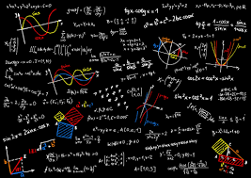
Icebreaker: What do we need?
Draw a circle of life and fill it.
The Conscious Community wants a nation of their own and to go do for self?
Why? Who? What? When? Where? and How?

Slide 3
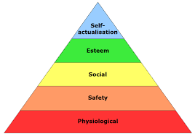
Needs of Humans (society) on this planet
Air
Food
Water
Shelter(Space)
Clothing
Sanitation
Education
Healthcare
Employment/Trade
Transportation
Weapons Defense/Offense
Justice System
Government
Communication
Currency? (Yes or No)
Other?

Slide 4
Handout Exercise 1 Page 2
How are your basic needs met and how it was meant to be

Slide 5
Greatest Country in the World! Because?

Slide 6
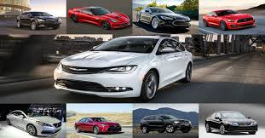
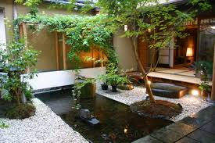
American Dream

Slide 7
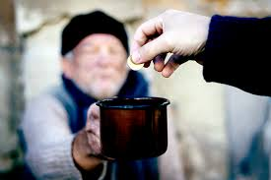
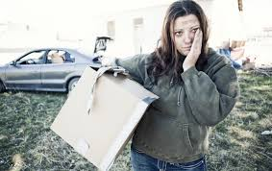
???? Is this America as well????

Slide 8
Hand out Exercise 2 Page 6
Your Billion Dollar Allocation

Slide 10
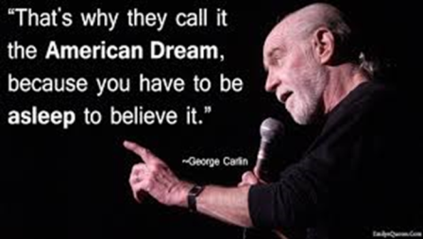
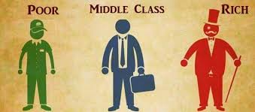

Slide 11
On the Death of U.S. Capitalism By James Stewart (LaVida News Staff 1995)
The ugly truth to current economic times is that the rich are getting very much richer and the middle class is falling deeper and deeper into debt as the middle class attempts to maintain their standard of living. Elected officials no longer ask their voters what their opinions are concerning pending legislation. Instead elected officials vote according to whatever lobby provides them with the greatest contribution and the two most powerful lobbies at both the state and federal level are the insurance and energy industries…
As global companies such as Walmart, American Airlines, General Motors, Exxon Mobil and AOL-Time Warner continue to demand concessions from their workers through the threat of layoffs and union busting the American worker is becoming less and less important in the decision making process of industrial industries.
The average CEO now makes 100 to 1000 times as much as an employee. Every decision that is made concerning the health of the industry is made with the CEO’s best interest in mind.
Gated communities were once considered un-American and completely over the top. Today, they are just another sign of class and economic division.
Increasingly un-checked capitalism is proving not to be the ally of the working class.
Either the US will become an aristocracy or it will become a socialist state.
(It is predicted), The great American experiment in Capitalism will give way to an absolute aristocracy by the year 2075.

Slide 12
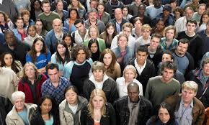
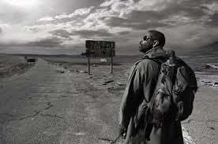
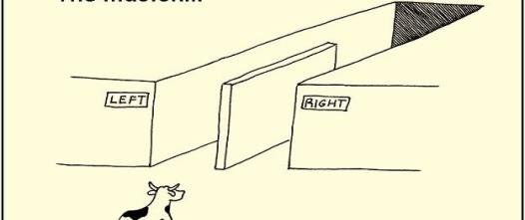
Cognitive Dissonance
Backfire Effect

Slide 13
The Revolution, the Struggle….what is it?

Slide 14
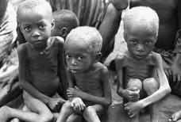
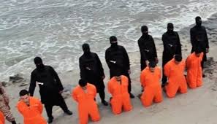
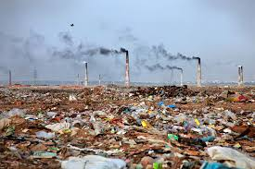
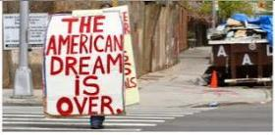
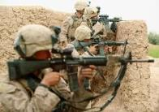

Slide 15
So………

Slide 16
With that said…..???

Slide 17
Conscious Community (Reality vs. Alternative Reality)
Yes, definitely
Without a doubt, No

Slide 19
The Matrix

Slide 20
The Deprogramming of the Negro

Slide 21
The N-variable Place holder for Original PowerPoint
Presentations are provided here at Bean Soup Science Online for free. For details to the entire PowerPoint, workshop prices, scheduling dates and times, please send inquiries to: corenovus@gmail.com

Slide 22
Both are black and loved by the Creator. Both serve a purpose. Who is made for the future? Who is made to exist in this world AND the next? One? Both? Neither?

Slide 23
Dehumanization of victims
Place holder for Original PowerPoint
For details to the entire PowerPoint, workshop, prices, dates and times, please send all inquiries to: corenovus@gmail.com

Slide 24
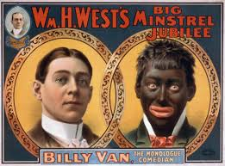
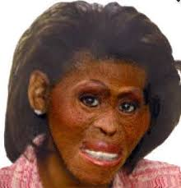
Business Entertainment War Neighborhood Schools Government Work place Dating Career Religion Environment HealthCare Marriage Family Prisons Police Weddings Food Future Past

Slide 25
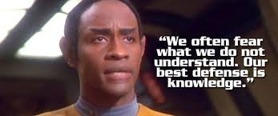
The Requirement for a Nation

Slide 26
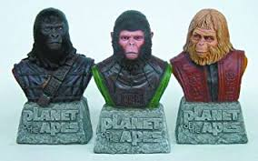
Military?
Workers?
Scientists?
The Basics of Civilization
“The supreme art of war is to subdue the enemy without fighting.” ...“If you know the enemy and know yourself, you need not fear the result of a hundred battles. ~Art of War
“The only effective answer to organized greed is organized labor.” ~ THOMAS DONAHUE
“Science is a way of thinking much more than it is a body of knowledge.” ~ Carl Sagan

Slide 27
Hand out Exercise 3 Page 10
Cultural Engineering 101

Slide 28
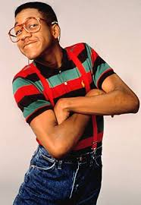
Nation Building starts with the right people to build. Reinvent yourself…. Start with a new core.
Maat principles Religion
Healthy lifestyle Diets
STEM based careers Job/sports
Minimal lifestyle Keep up with Jones
Live the plan Know the plan
Thought Police or mastery of emotions while living as a example?

Slide 29
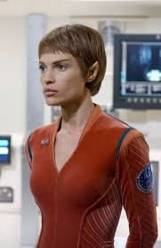
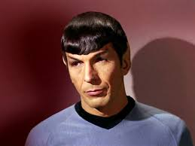
The Intellectual deconstruction of emotions “T'san s'at” is the intellectual deconstruction of emotional patterns, the process by which Vulcans were able to control their emotions. It is a life-long process.
(Fictitious race called Vulcans from the Star Trek Series).

Slide 30
Love, Logic and (Science)Literacy

Slide 31
Values and social class systems from 1837 to 1901. It was a long period of peace, prosperity, "refined sensibilities" and national self-confidence for the United Kingdom.
“Control Yourself”
Today

Slide 32
Core Novus Techniques for “refined sensibilities.”
Place holder for Original Power Point
For details to the entire PowerPoint, workshop, prices, dates and times, please send all inquiries to: corenovus@gmail.com

Slide 33
Ma’at and Unity

Slide 34
The Renaissance was a period in European history, from the 14th to the 17th century, regarded as the cultural bridge between the Middle Ages and modern history. Wikipedia
Period: 1300 – 1700

Slide 35
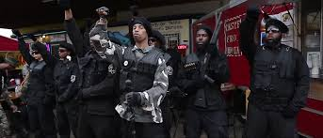
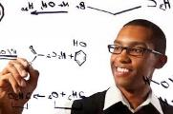
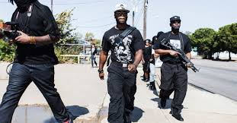
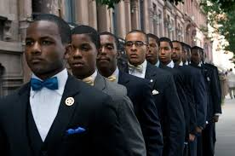
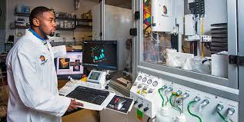
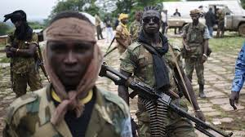
(From Revolution to Renaissance)
Separation ≠ Independence and Independence ≠ Separation
An Army?
or
An Army?

Slide 36
Hand out Exercise 4 Page 15
Needs of society, Needs of a nation, Needs of the Planet, The need in you

Slide 37
The SYSTEM
For details to the entire PowerPoint, workshop, prices, dates and times, please send inquiries to: corenovus@gmail.com

Slide 39
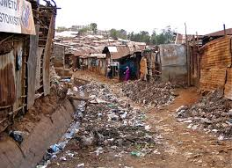
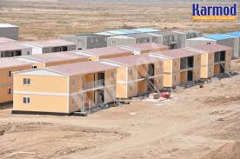
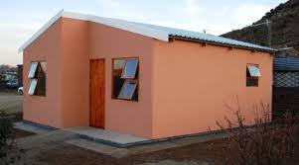
You don’t know Africa.

Slide 40
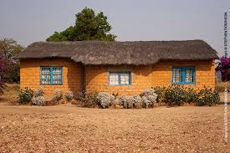
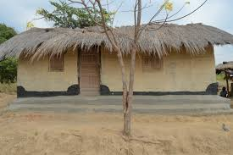
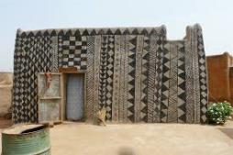
Africa today in most areas

Slide 41
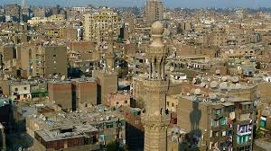
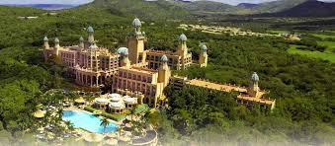
African Cities

Slide 42
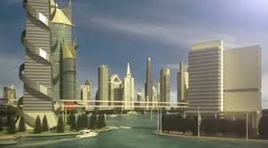
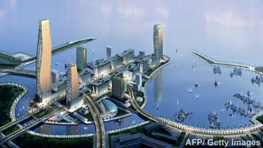
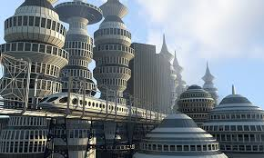
What do we want?
What do they want?

Slide 43
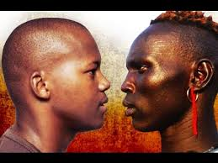
Choice
Will African Americans accept Africans and Africa as a home land?
Will Africans accept African Americans and this African American plan?

Slide 44
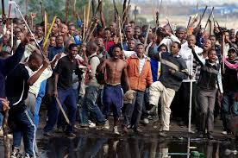
Same Difference
2015 - 2016

Slide 45
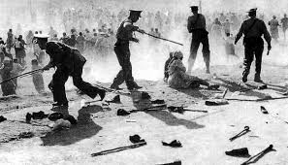
1960’s

Slide 46
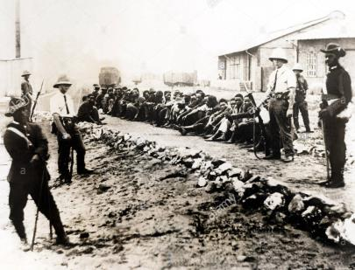
1930

Slide 47
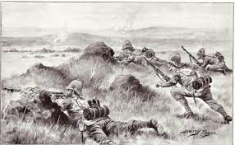
1900

Slide 48
1800

Slide 49
More than just something in common, we are the same.

Slide 51
Exercise 5 Page 17
But I’m always me

Slide 52
End of Part I

Slide 53
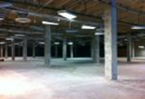
A Nation Building Plan
Part II
www.corenovus.org
Introducing
Dead Mall Projects

Slide 54
A transparent, humanitarian, all inclusive, global, green, transhumanistic, multi-planetary, cultural & psychological changing
Plan.
The Past
The Present
The Future
You belong in America, should reclaim
the Diaspora and begin to
create the United States of Africa

Slide 55
http://www.greeninfrastructurescotland.org.uk/green-infrastructure-community-engagement-fund

Slide 56
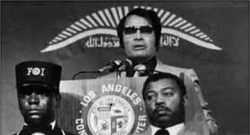
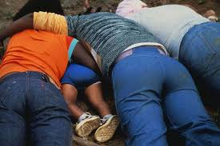
People
Plan
Money
Land
Equipment
Facilities
Community Infrastructure
Trucking
Sea/Airports
Export / Import
African Infrastructure

Slide 57
Post Nation State Core Novus The Conscious Community Plan Potentials
Reparations in the form of low cost international trade (exports/imports)
United States of Africa Development
Dual citizenship (America & Africa)
Better life, better society (Self governed)
Global Humanitarian Agency Service (A FEMA)
Central Oasis Astro/Sky Terminal
(COAST) Low orbit Satellite repair
Free Health care
Free/low cost energy
Free Education
City States (Outside of Africa)
A unifying language
Our own monetary system
First Psychic Research Center
Unified African Transportation System
Aeronautics/Space Agency & Program
The Green Wall Initiative
Tourism

Slide 58
Pre Nation State
Investors
Commerce
Foreign investors
Industry
Trade
World Bank
Federal Reserve System
Capitalism
Resource Based Economy
Barter/Modified Versions
Credit systems/Bit coin
World Bank Alternative
Alternative Monetary Systems
Core Novus Plan, not lucrative nor entrepreneurial, based in scientific socialism and a whole lot of love and sacrifice.

Slide 59
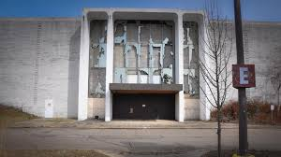
“Dead Malls”

Slide 60
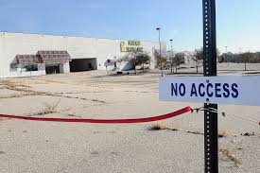
Space within the same community

Slide 61
Dead Mall Projects (City-State Experiments for the larger picture)
Control Group – The Community
Experimental Group – Dead Mall Projects

Slide 62
The need for Dead Mall Projects….Why?
Experimental group (Mall) and
Control group (surrounding community)

Slide 63
Nation Building businesses and projects ONLY!

Slide 64
(Handout exercise 2 Page 5)
Nona’s hair salon, Omar’s convenient store, Nancy’s boutique, Ernie’s Auto repair

Slide 65
Quick Quiz

Slide 66
Right here in the good ol’ U, S of A?
What do you have? Really?
Human Resources
Sovereignty
Territory (Protection?)
Government
Air/Sea Port
Minerally Rich Land
Education
Space Agency (National Purpose)
Material Resources
Reparations? Probably not even though other races like Jewish and Asian Americans received theirs.

Slide 67
Equipment, products and supplies made here and needed there.
Civilization starter kit | Marcin Jakubowski | TEDxKC

Slide 68
Unity is needed more so than money, land resources, etc., for a nation to thrive.

Slide 69
(Handout Exercise 1 Page 2)
Products and Services we need

Slide 70
What can you do to create a Dead Mall Project in your area?
Find like minded individuals.
Find endorsers & investors – schools, churches, mosques, unions, neighborhoods.
Stay in touch – www.corenovus.org (network)
Make connections in Africa (visit, people & places).
Much more

Slide 71
By the way, why a space agency? NERD!

Slide 72
Space Industrial Complex and economic growth
Place holder for Original Power Point
For the complete PowerPoint, workshop dates,
times and prices, please send inquiries to:
corenovus@gmail.com

Slide 73
(Handout Exercise) 2 Page 9
Prepare a generation for the future

Slide 74
Getting Started….accidently on purpose.
Examples of American CIA interference with other governments.
1975 – Australia, orchestrated propaganda and political pressure to force out labor government of Gough Whitlam. Successful.
1976 – Jamaica, military coup to overthrow government of Michael Manley. Unsuccessful.
1976 (1979) - Jamaica, supported attempts to assassinate Michael Manley. Unsuccessful.
1979 - Iran, Attempt to install military government to replace the Shah and curb the growth of Islam. Unsuccessful.
1979 - Jamaica, Apply financial pressure to destabilize government of Michael Manley, campaign of propaganda and demonstrations to defeat Michael Manley in elections. Successful
.
1980- Afghanistan, provide military aid to rebel forces trying to harass Soviet occupation forces. Inconclusive.
1981- Libya, Orchestrate campaign of economic pressure, propaganda, and military maneuvers to destabilize government of Muammar Qaddafi. Inclusive.
Harper’s April 1984

Slide 75
This is NOT anti-American. We don’t have to make the same mistakes of this nation:
Post Industrial Age
Diversity Complete/Full
No Borders, No Classes
Space Industrial Complex
No Monetary Systems (Alternatives)

Slide 76
Solar Power Technology
Water purification Systems
Off the Grid Technology
Construction Technology, Equipment, materials, etc.
Robotics
Herbal Pharmaceuticals
Meat/Fish processing
Farming Technology
Communal living
Humanitarian Sciences/Services
Perfecting systems, technology and ideas here.
Don’t get it twisted (Transparency)
Export/Import Products & services to Africa.
Helping Humanity as a whole.

Slide 77
Make the things everyone needs
Modular, Efficient, self sustaining, cheaper, better

Slide 78
How the United States of Africa gets its Products & Services
Trips are necessary. Cargo is transported, transactions and assignments dictated by requests for humanitarian aid & special projects.
In Africa, goods, products and services are shipped in airports and seaports to holding towns. From there, they are trucked/ferry to designated locations.
Fundraisers, mailings, Import/Export business, and other sources from dual status citizens & emigres. Money is immediately turned into Product/Service & Skill payment(s).
Dispensed by need in Nation building tiers.
FUNDS RAISED ARE SPENT ON TRAVEL FOR SPECIALISTS, MEDICAL SUPPLIES, INFRASTRUCTURE, EQUIPMENT, AND AID, ETC.

Slide 79
No reason to reinvent the wheel. Strive for perfection.
Business Models
and
Marketing strategies

Slide 81
Community

Slide 82
What do Africans want?
Exit strategies for Africa: What do we do with the dictators?
“What African states now under strongman rule need is help from the international community to ensure a peaceful transition to democracy and to negotiate an exit strategy for the strongmen who now feel that their only option is to tighten control in order to stay in power- and thus avoid the threat of prosecution. “
“ …Our conditions should include that they stop the repression and agree to a timetable on a peaceful, negotiated transfer of power. They must also return some of the millions they ferret away in foreign accounts. “
“We could also specify that what we offer is a onetime deal, with a deadline attached…comfortable retirement, free of retribution.”
By Edward J. Von Kloberg III

Slide 83
Comm-Unity (African Infrastructure)

Slide 84
Becoming A Nation By Jim Hoagland Washington Post Sunday, December 5,1999
“Speaking about victims in Chechnya enduring Russian bombs and shells.” Victimization alone is not sufficient to win an ethnic group or a captive territory the right to nation hood.
There is no guarantee of self determination for ethnic nations in this era of collapsing empires (the Soviet Union) and the implosion of tyrannies masquerading as states (Yugoslavia, Iraq). Nationhood has to be won and managed.
This is true even for ethnic groups that gain the world’s sympathy through their suffering and whose populations and economic resources exceed those of many mini states that have been automatically handed U.N. membership through quirks of history and decolonization.”

Slide 85
The New Middle Passage moving products, services and people both ways.

Slide 86
Final thoughts… The past must be the past, the future is our concern. Avoid cults, cult thinking & ridiculously strict rules and Draconian behavior. This is not meant to make a profit, zero cost. Learn all you can, serve humanity, seek the Creator.

Slide 87
Products & Services…. This has to STOP or we are going nowhere
Remember suggestions:
Majors in the STEM.
Music, Sports, Drama are hobbies (secondary).
Apply for NASA, SpaceX, Virgin Galactic, Texas Central Bullet Train, Energy, Humanitarian Organizations, etc. be at the forefront of space industry and cutting edge of technology.
Social Media 10 Africans & 10 South Americans
Learn a second language
Learn a computer language
Keep Religion, but always maintain Science
Start an account at oneunited
Bank.
Before marching, protesting and picketing, start building & investing. Independence is not separation.
Not everyone can own a business. You can work for your people. You don’t have to reinvent the wheel and be the boss.
“Refined Sensibilities,” Logic and healthy lifestyle.
Be proud and produce.

Slide 89
This world lacks consciousness….
Our purpose is to return it.
C.S.T.E.M.M.

Slide 90
End
A Nation Building Plan
Actually, this is the beginning

